Slide 1
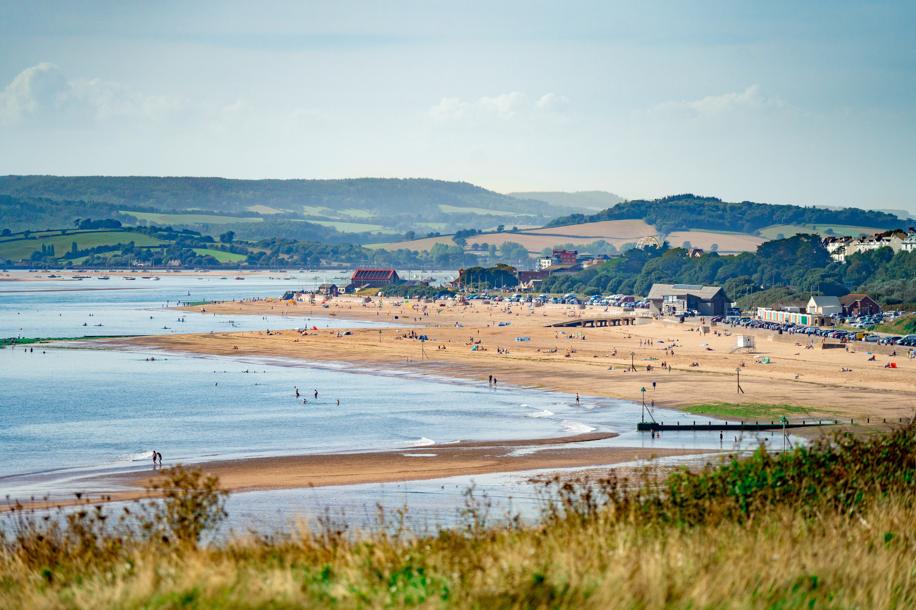

“SUSTAINABLE
SHORES”
Zoey Cooper, Climate and Comms Officer

Slide 2
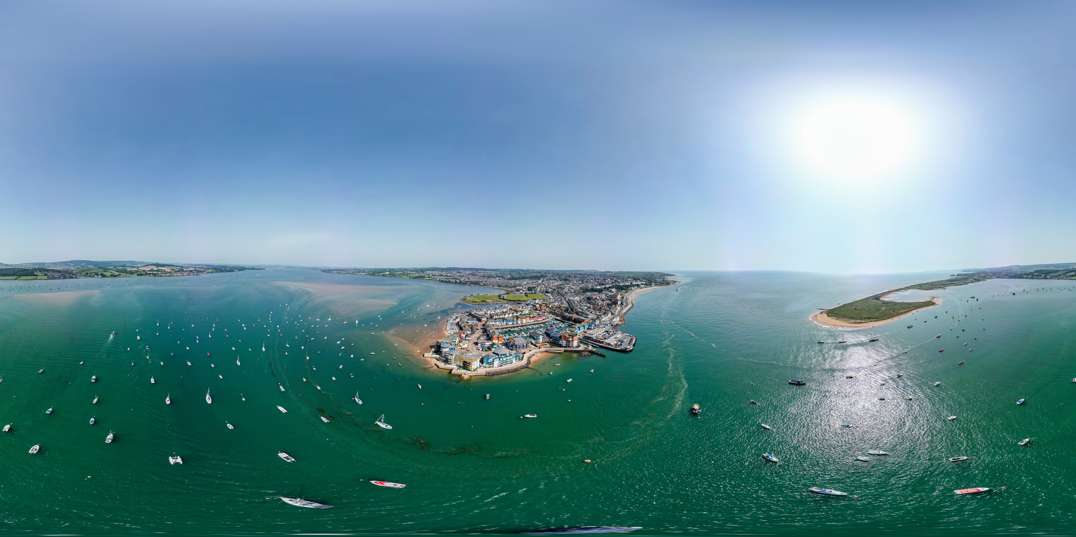
SETTING THE SCENE
Exmouth is the largest town in East Devon, with a population circa 37,000
2019: Exmouth Town Council (ETC) declared a climate emergency
2020: ETC commissioned a consultancy to assess its carbon footprint and established a dedicated working party
The working party invited Transition Exmouth to attend bi-monthly meetings.
Together, we developed a ten-point climate action plan.
2022: Climate Officer joined the team
2023: Climate Action Plan ratified at Full Council & is ongoing
2025: Won ‘Climate Response of the Year’, NALC Star Council Award

Slide 3
OUR INFLUENCE
LEADING BY EXAMPLE
PROCUREMENT
PLACE-SHAPING
ENGAGING & EDUCATING
CONVENING
LOBBYING

Slide 4

(AWARD-WINNING) CLIMATE ACTION PLAN
FOOD
WASTE
ENERGY
TRANSPORT
NATURAL ENVIRONMENT

Slide 5
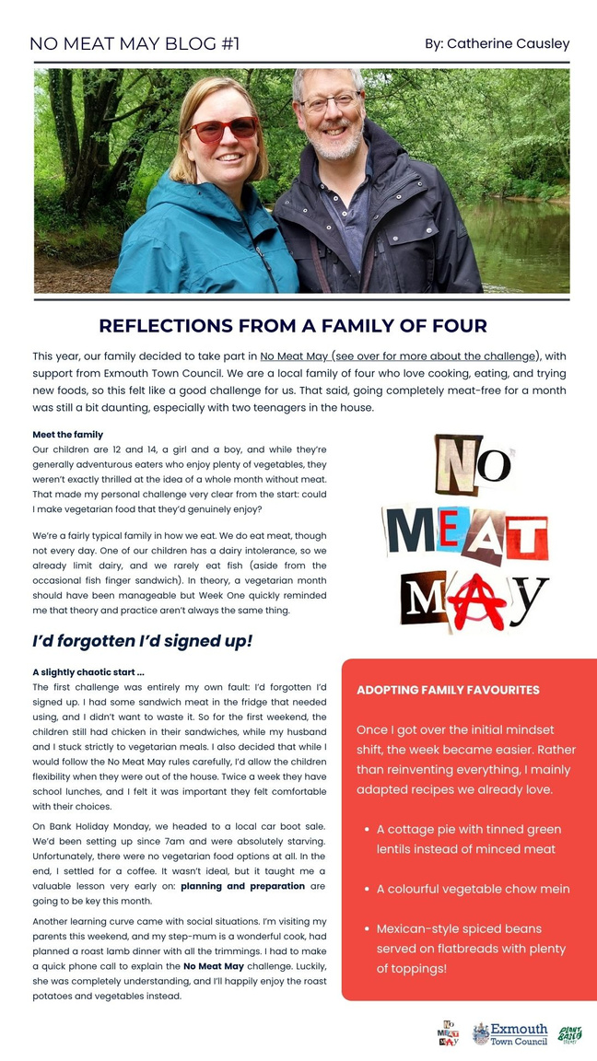



DIET CHANGE
Films and Q&A
Bring & shares
(Exmouth version)
Plant-rich blogs

Slide 6
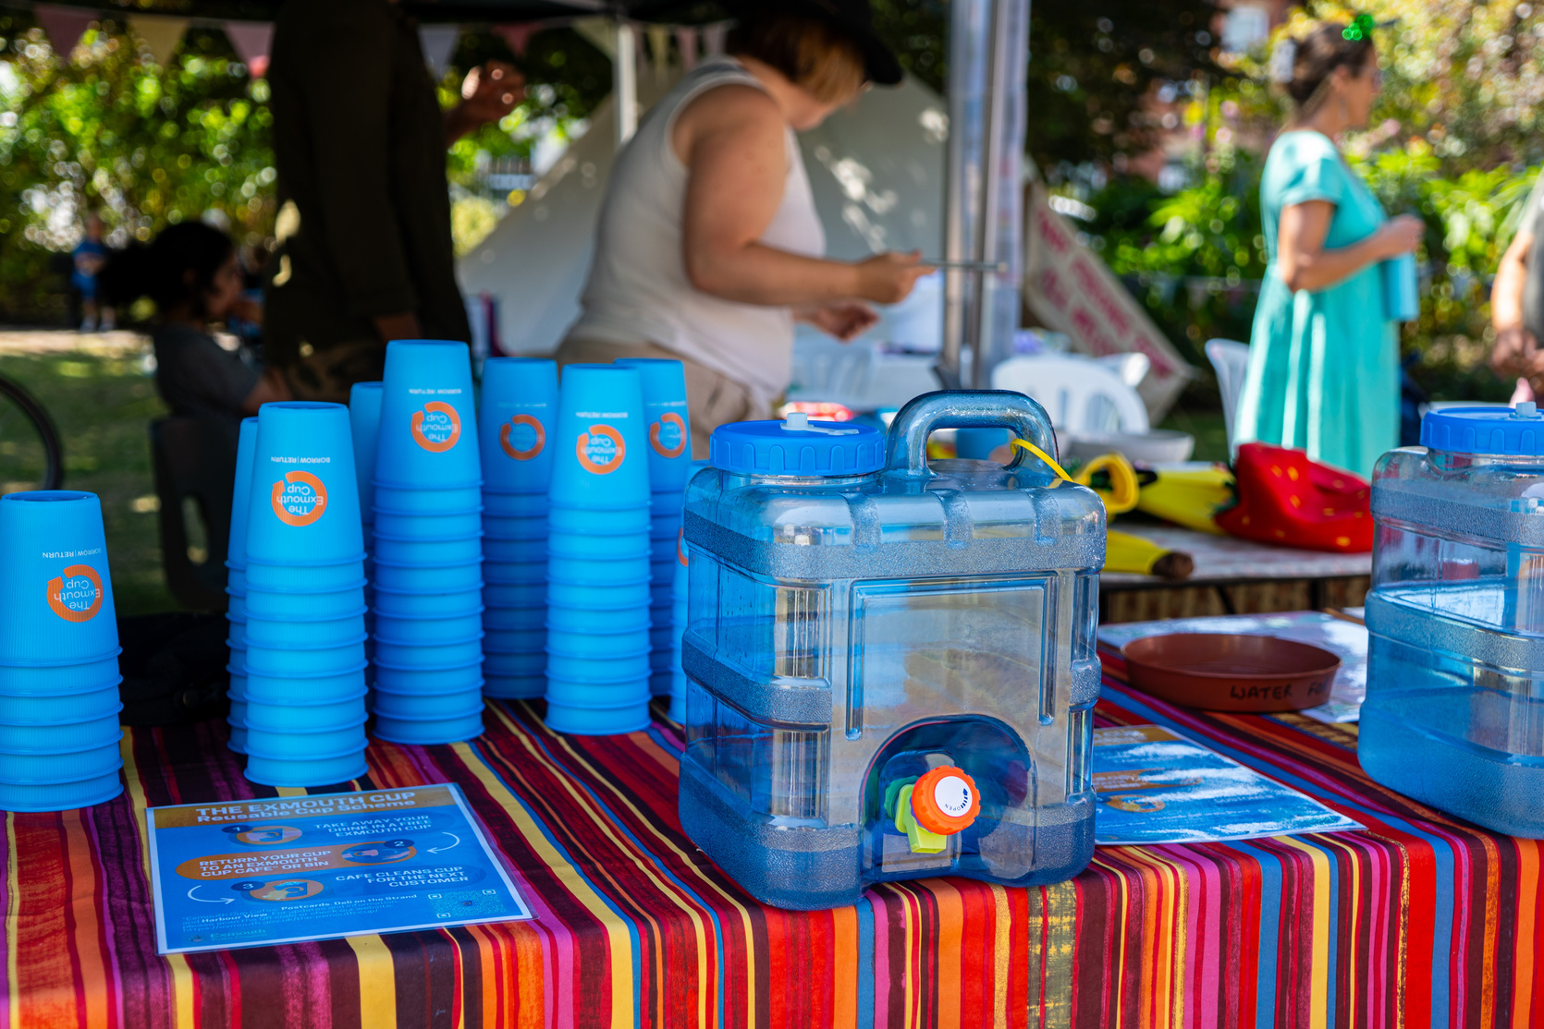
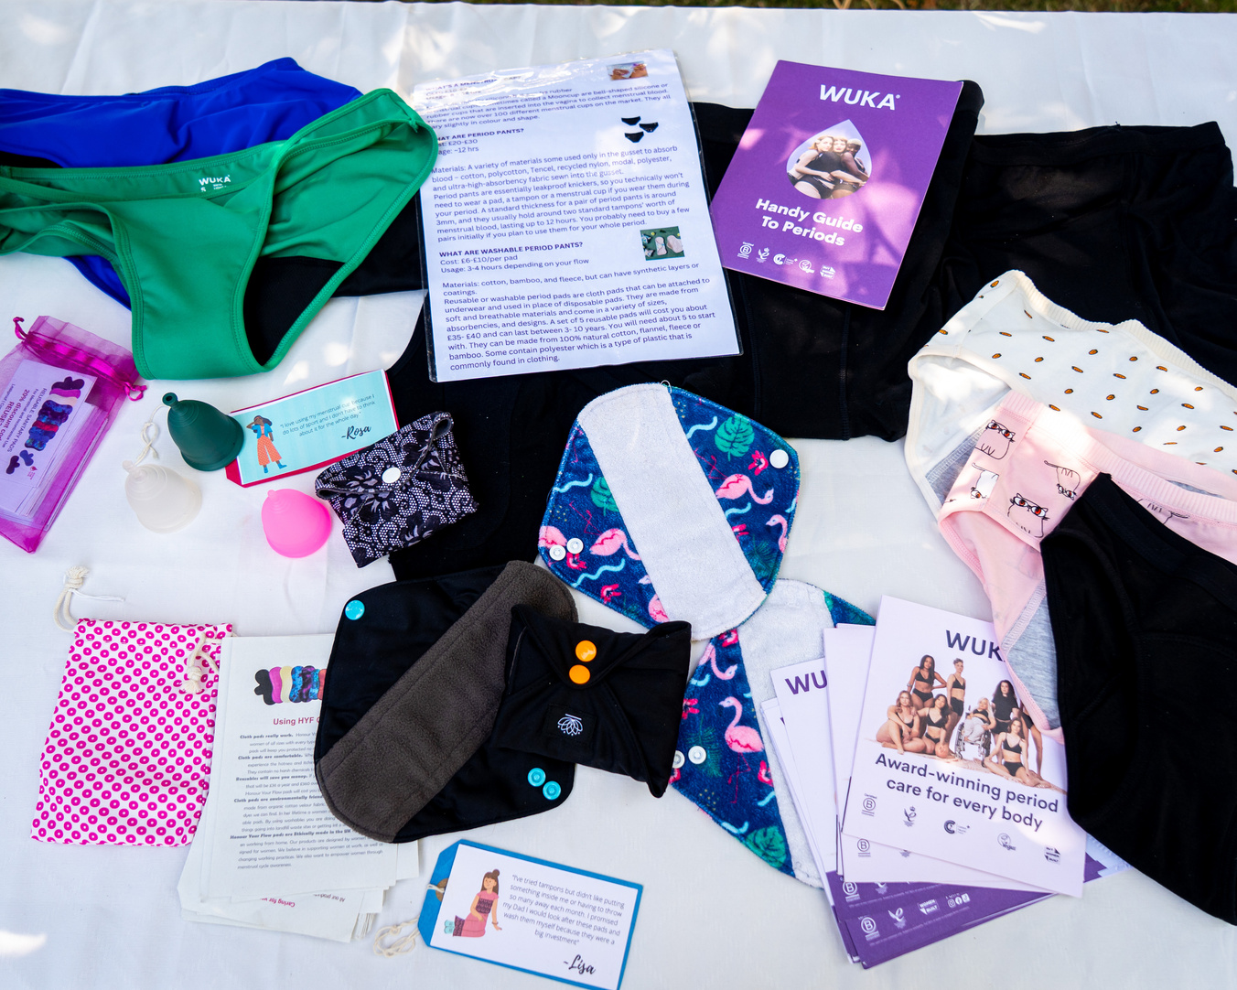
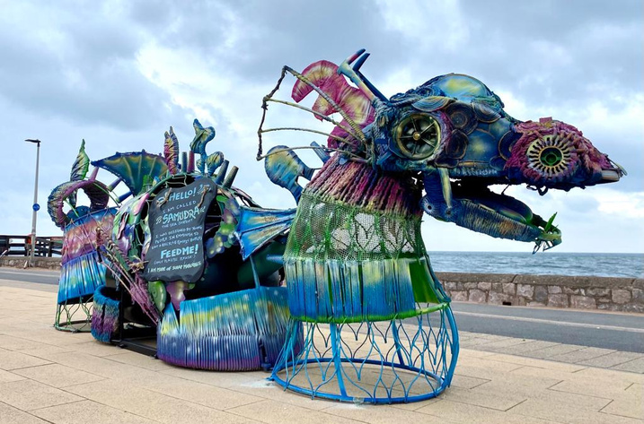
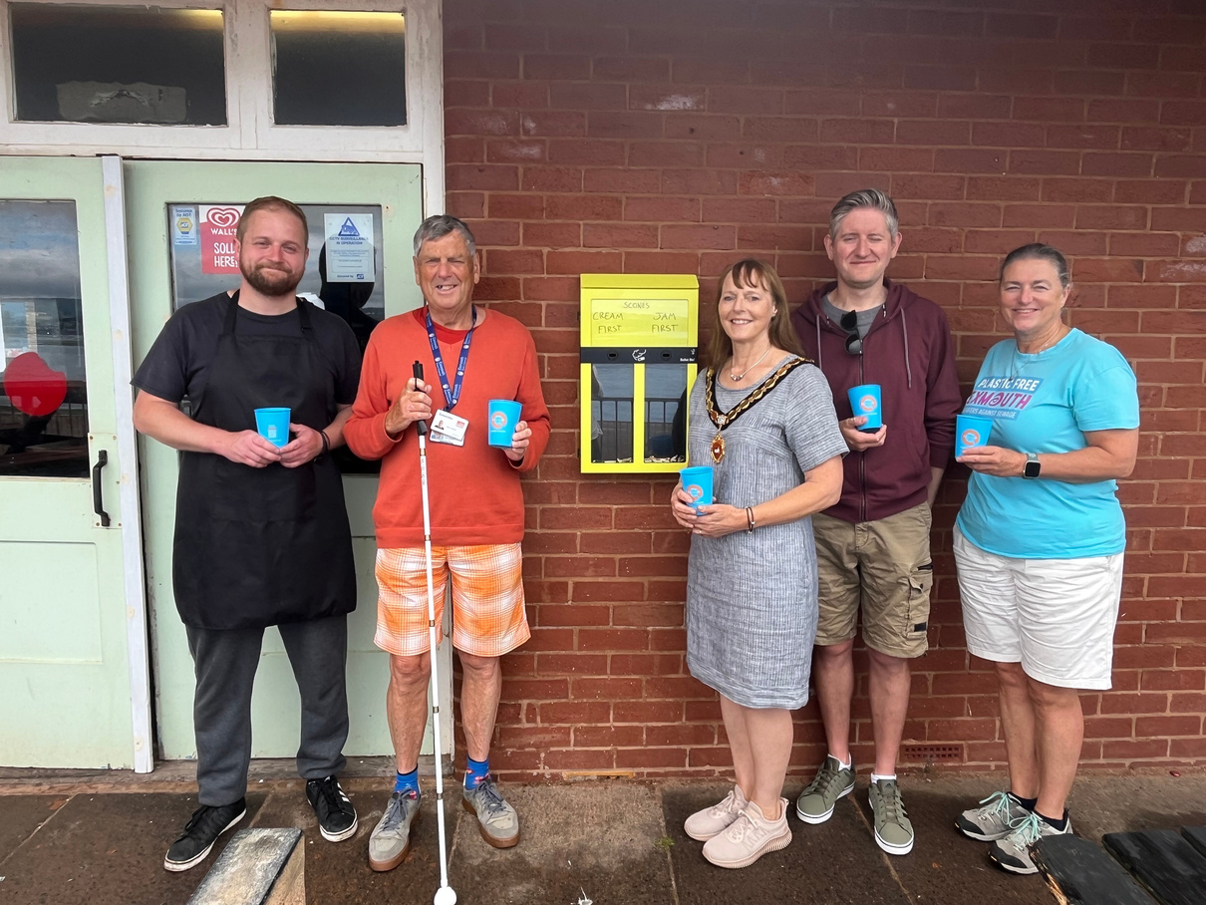
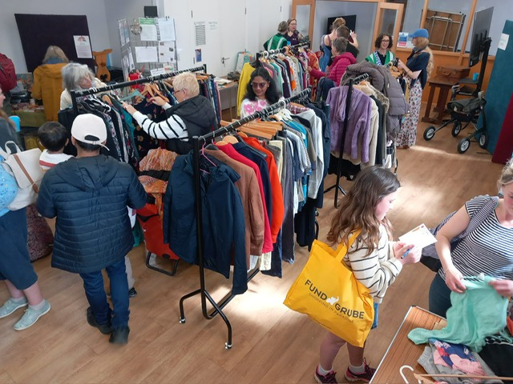
Exmouth Cup
Hygiene products
WASTE
Sea serpent
Butt ballot bins
Clothes swaps

Slide 7

ENERGY
ECOE Advice partnered with Exmouth Town Council to launch a pilot Retrofit Project
  The project stimulated conversations and inspired action around retrofitting homes in Exmouth to improve energy efficiency and sustainability.

Slide 8
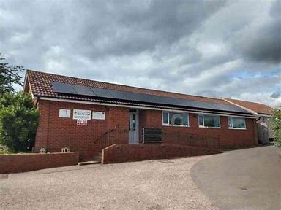
ECO ASSETS …
  Solar panels: 2021
  Battery (to harvest solar): 2024
  Rainwater harvesting
  Refresh and retrofit: 2024
  Local suppliers & contractors
  Tuk-tuk power

Slide 9
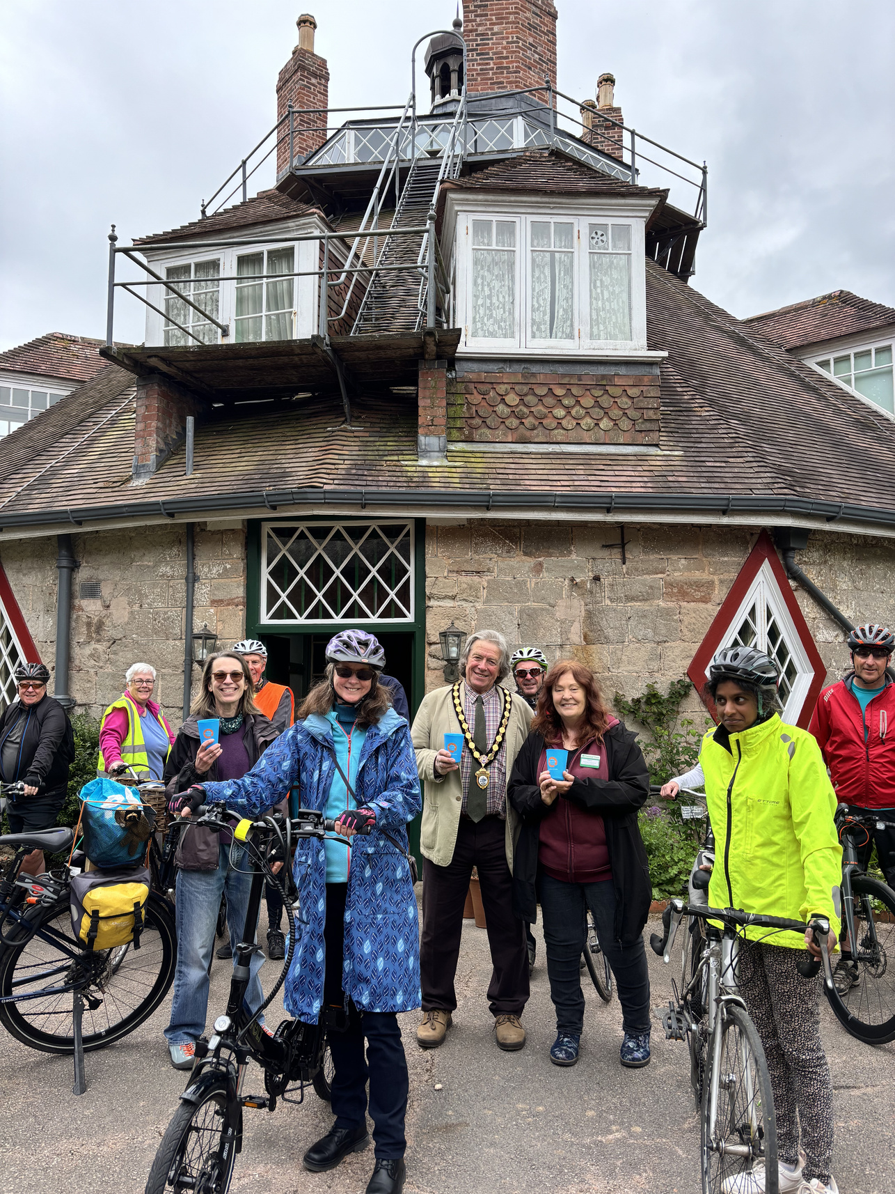

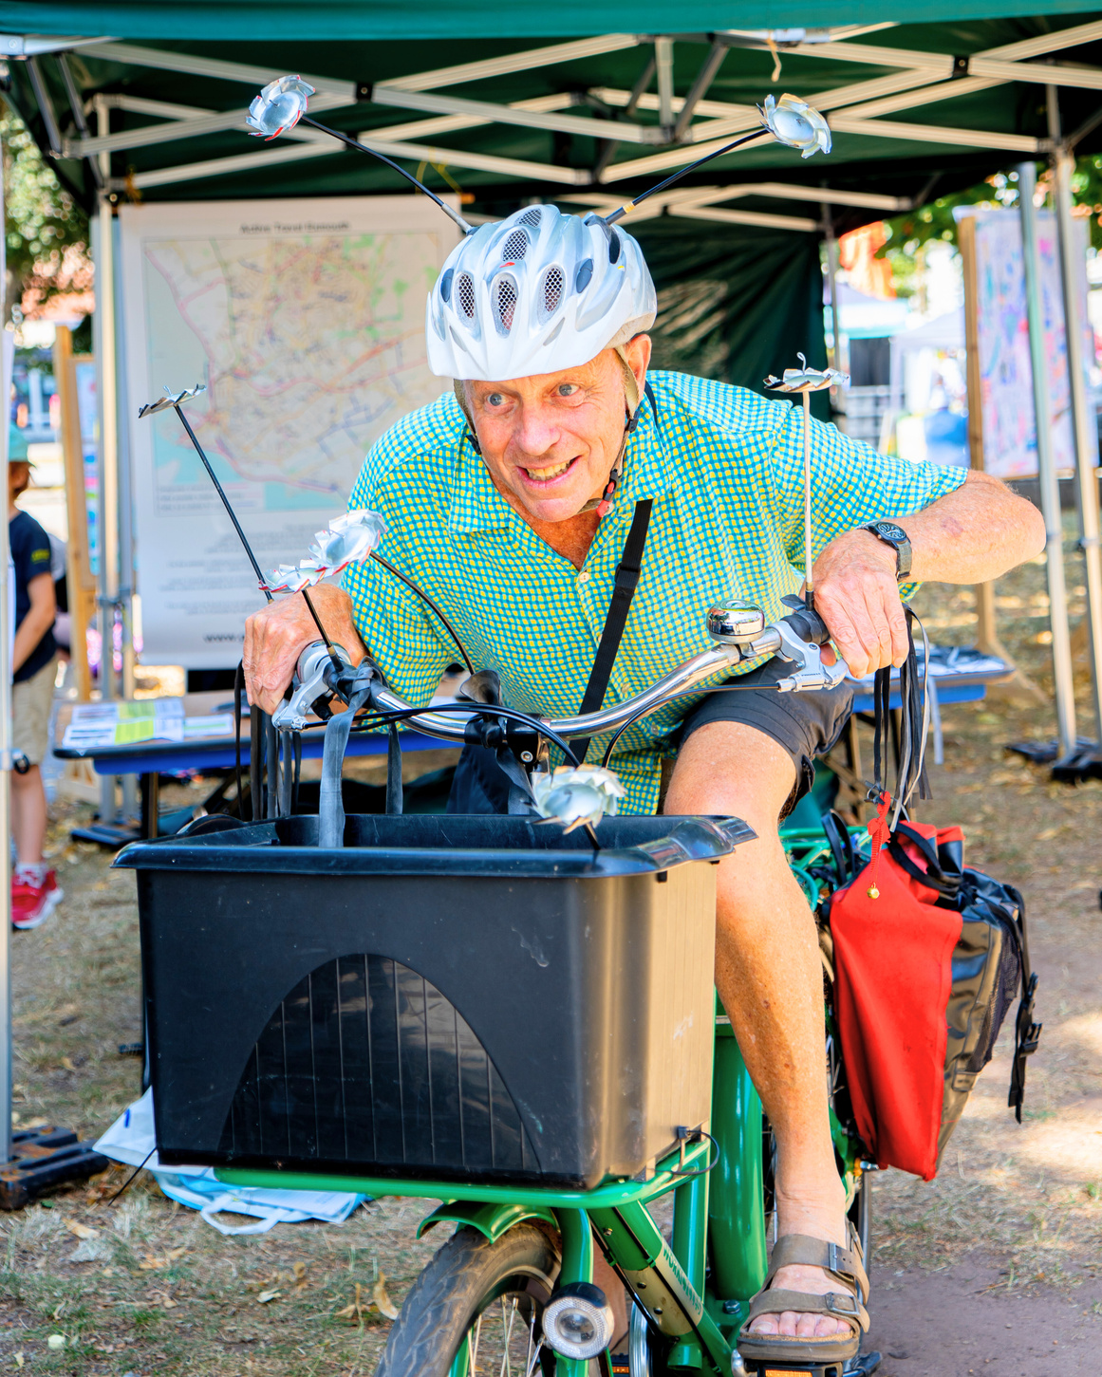
TRANSPORT
“Chasing The Sun”
Exmouth Festival
Active travel

Slide 10
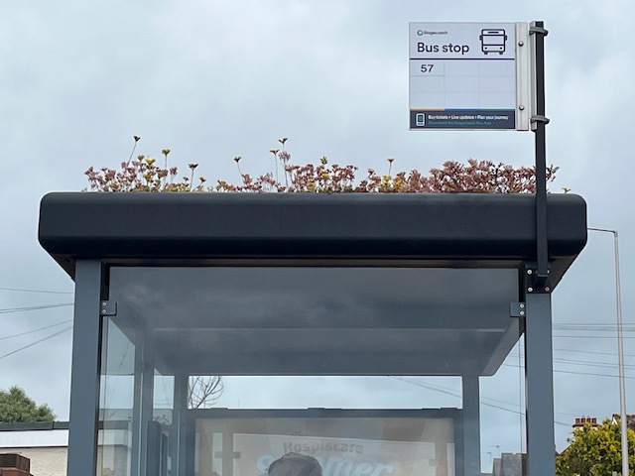
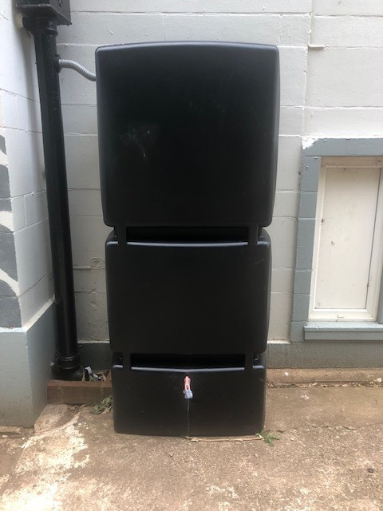
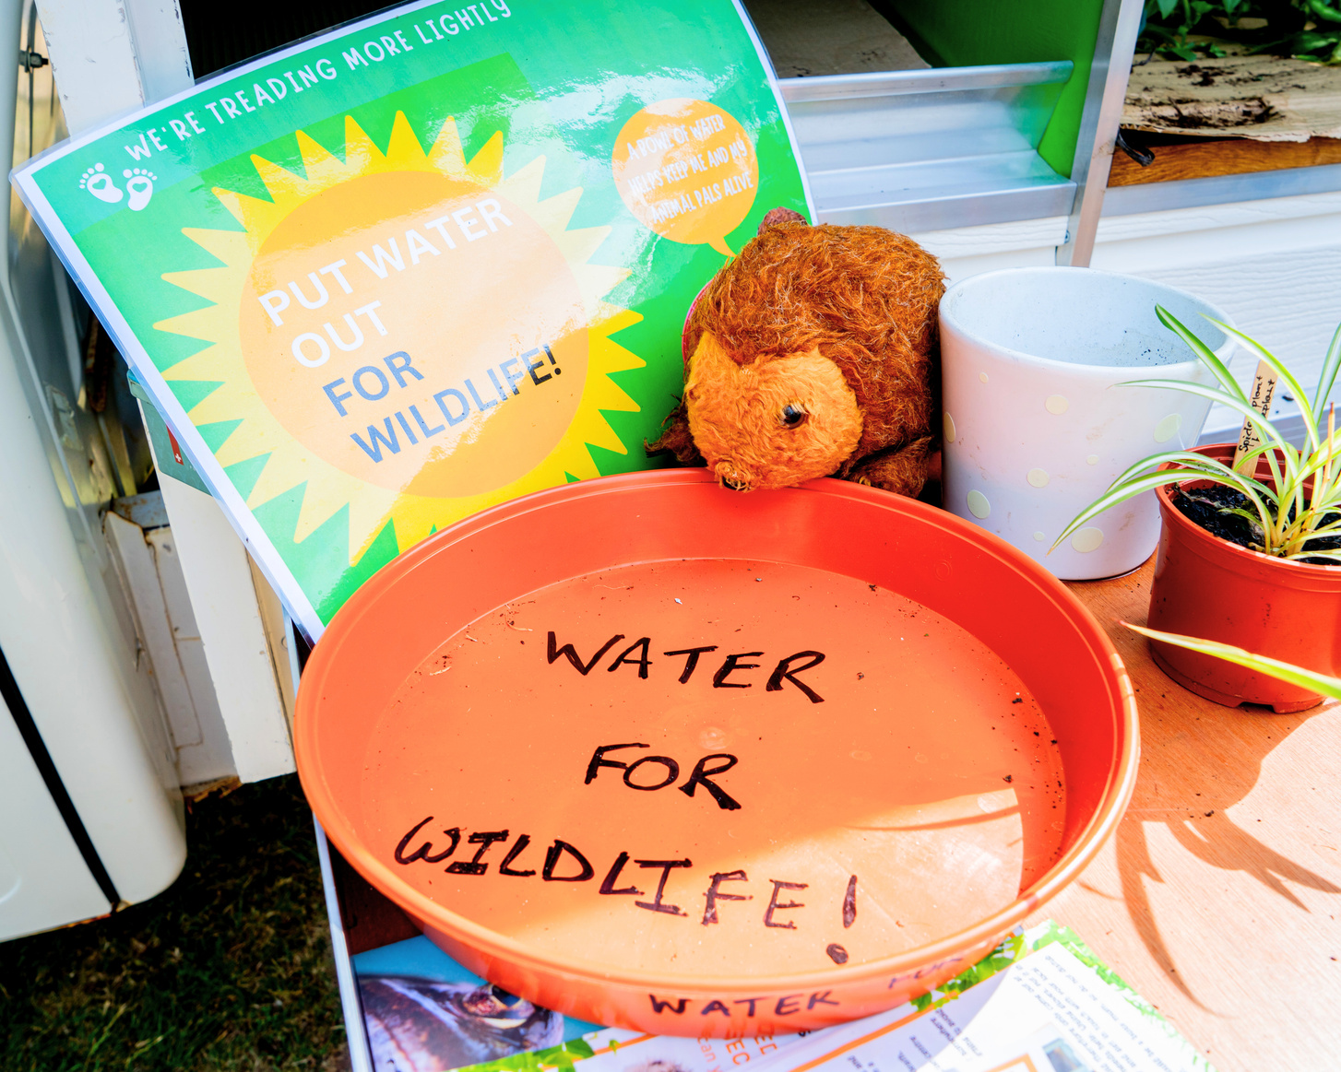
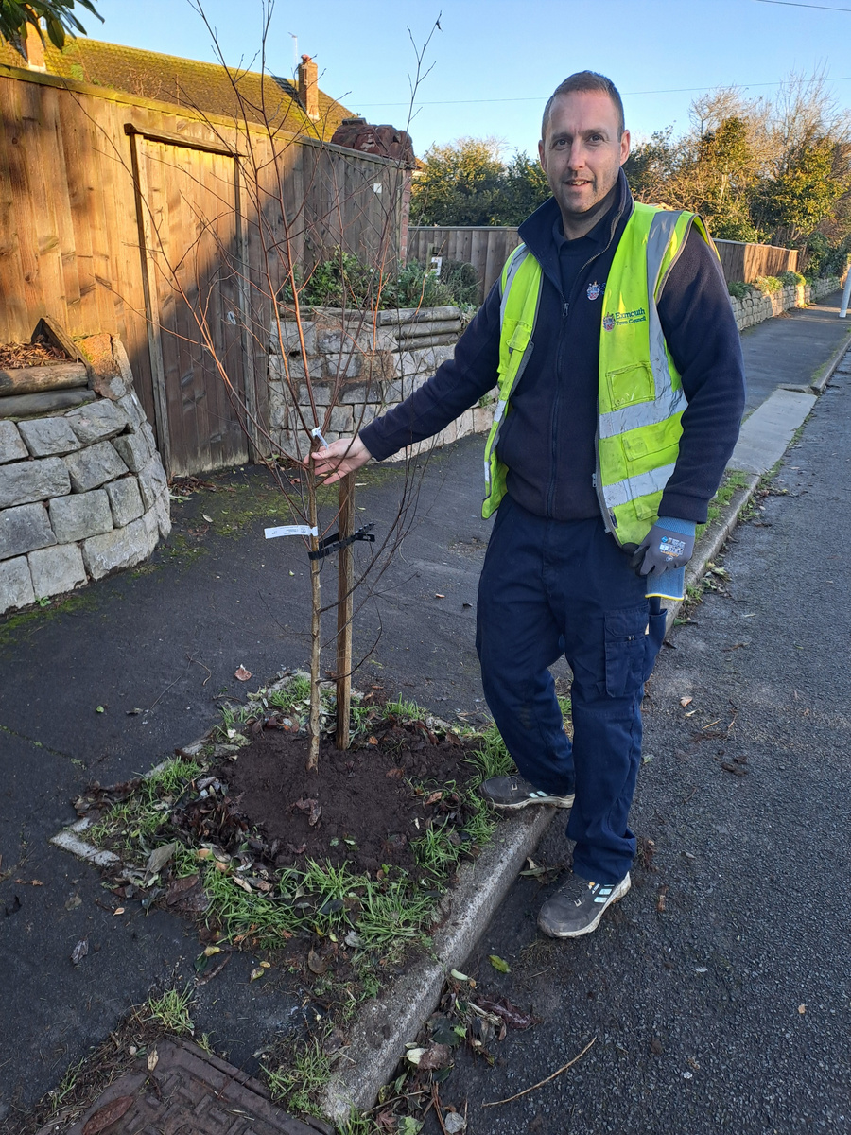
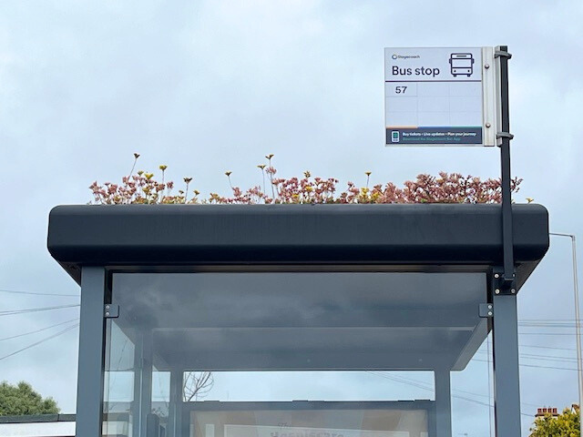
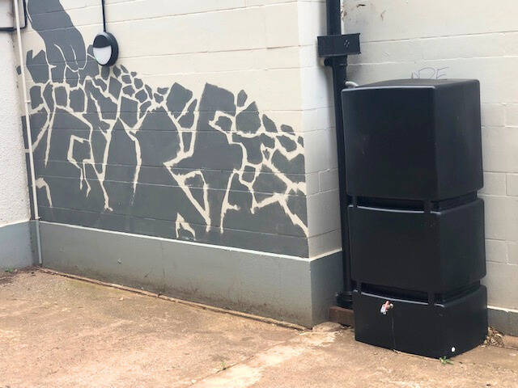
NATURAL ENVIRONMENT
Living roofs
Water butts
Wildlife
Trees

Slide 11
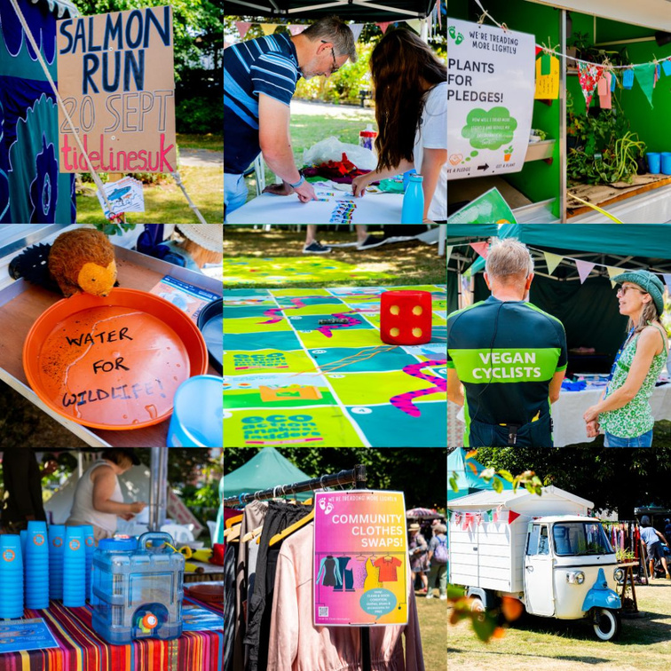

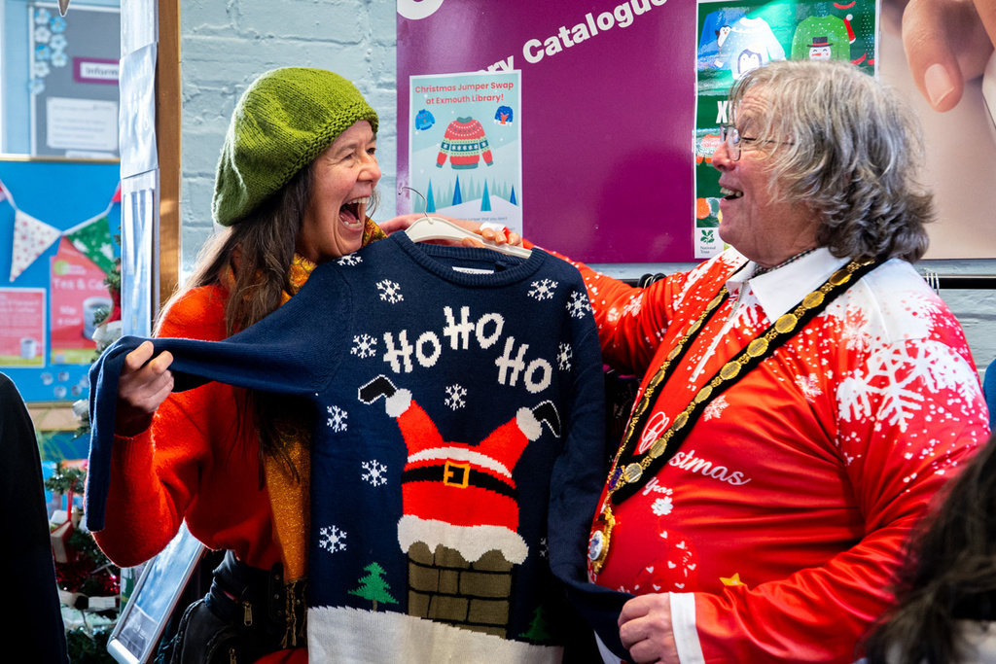
FESTIVALS & EVENTS
  As a town surrounded by sensitive ecological sites, it’s important the Exmouth Festival ‘treads as lightly’ as possible. Last year we hosted another Craft Your Christmas event.

Slide 12
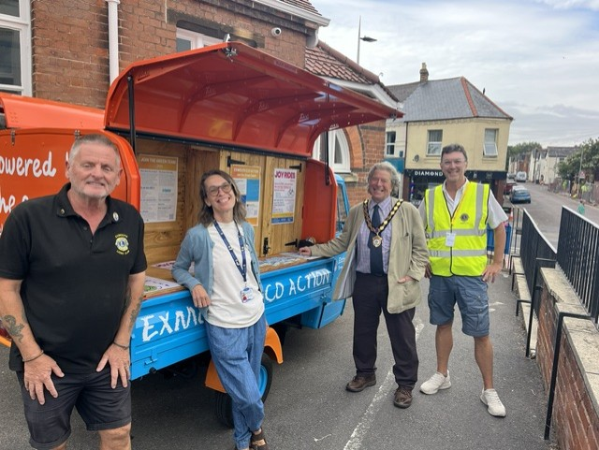
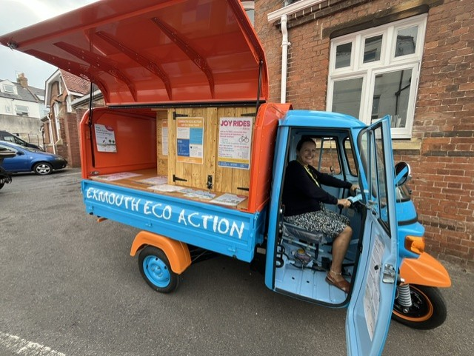
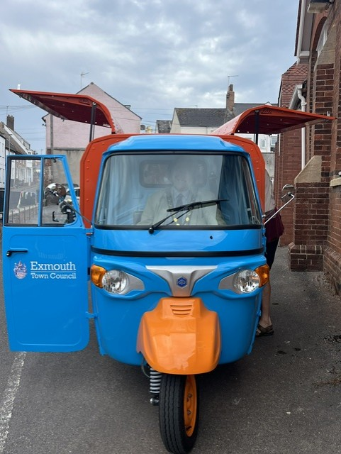

OUTREACH

Slide 13



Everything you need to host a screening: https://bit.ly/49cg3UX

Slide 14
FIVE KEY STEPS
Identify areas for impact and build partnerships with community organisations to meet those opportunities.
Identify areas of influence for all Working Parties and Committees. Lock sustainability into your Terms of Reference.
Assess and map existing climate initiatives in your Town or Parish (Council and/or local group-led).
As best you can, measure your carbon footprint. Most importantly, share your sustainability journey.
Develop a Climate Action Plan, lead by example & promote your efforts.

Slide 15

FINAL THOUGHTS ...
Be patient - change takes time. Your actions (large or small) will have a ripple effect across the community.
Listen to your community. Set clear expectations about what you can and can’t do.
Identify your allies! Learn from other Councils and take field trips for inspiration.
Identify areas of influence for all Working Parties and Committees. Lock sustainability into your Terms of Reference.
Encourage Council Members and Staff to take Carbon Literacy training.
Host a People’s Emergency Briefing
Screening
Develop a Climate Action Plan, lead by example & promote your efforts.

Slide 16
THANK YOU
Contact: climate@exmouth.gov.uk
https://exmouth.gov.uk/ecoaction

