Slide 1


Isle of Wight Social Virtual Power Plant
10th June 2026

Slide 2
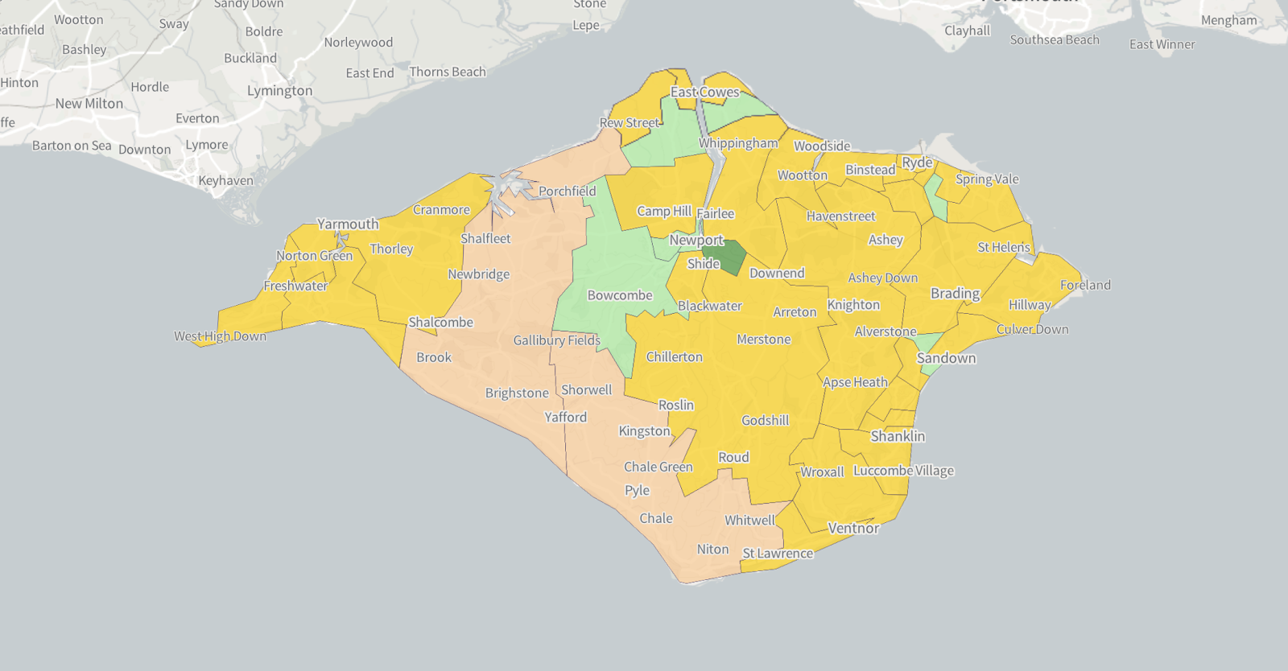
Average energy efficiency
Notes:
For people that don't know where we are, we are a small Island about 5 miles off the South Coast near Portsmouth... We are very roughly 25 miles by 13 miles and a bit crumbly around the edges.

Slide 3


Green Isle of Wight
What we do
Run local projects that cut carbon and improve daily life.
Work with communities to design practical, affordable solutions.
Help people access advice, support, and trusted partners.
A community interest company working for a greener, fairer Isle of Wight.
Notes:
So who are Green Isle of Wight ?we are a community interest company that helps people reduce their energy bills and makes peoples homes warmer and cheaper to heat.
Last year over 4,500 attended our Outreach sessions on the Island and we provided individual advice to over 700 households, about half of these were through home visits where we were able to install easy energy saving items

Slide 4



Our mission
Lower bills over time
Local energy, used locally
A fairer transition
Make it easier for households to save money on electricity — especially those who need it most.
Keep more of the Island’s clean energy on the Island — storing it when there’s extra, using it later.
Community ownership and shared benefits — not just for people who can afford new tech.
A “fair” energy transition for the Isle of Wight
Notes:
With our Battery Project we want to provide a longer term solution to reducing energy bills rather than the sticking plaster approach of providing energy vouchers, we believe that if we are going to move towards a “clean” energy system then it needs to be fair for everyone and we need to help those who most need it.

Slide 5

What’s the problem?
What’s the problem?
Notes:
So what problems do we face ?

Slide 6
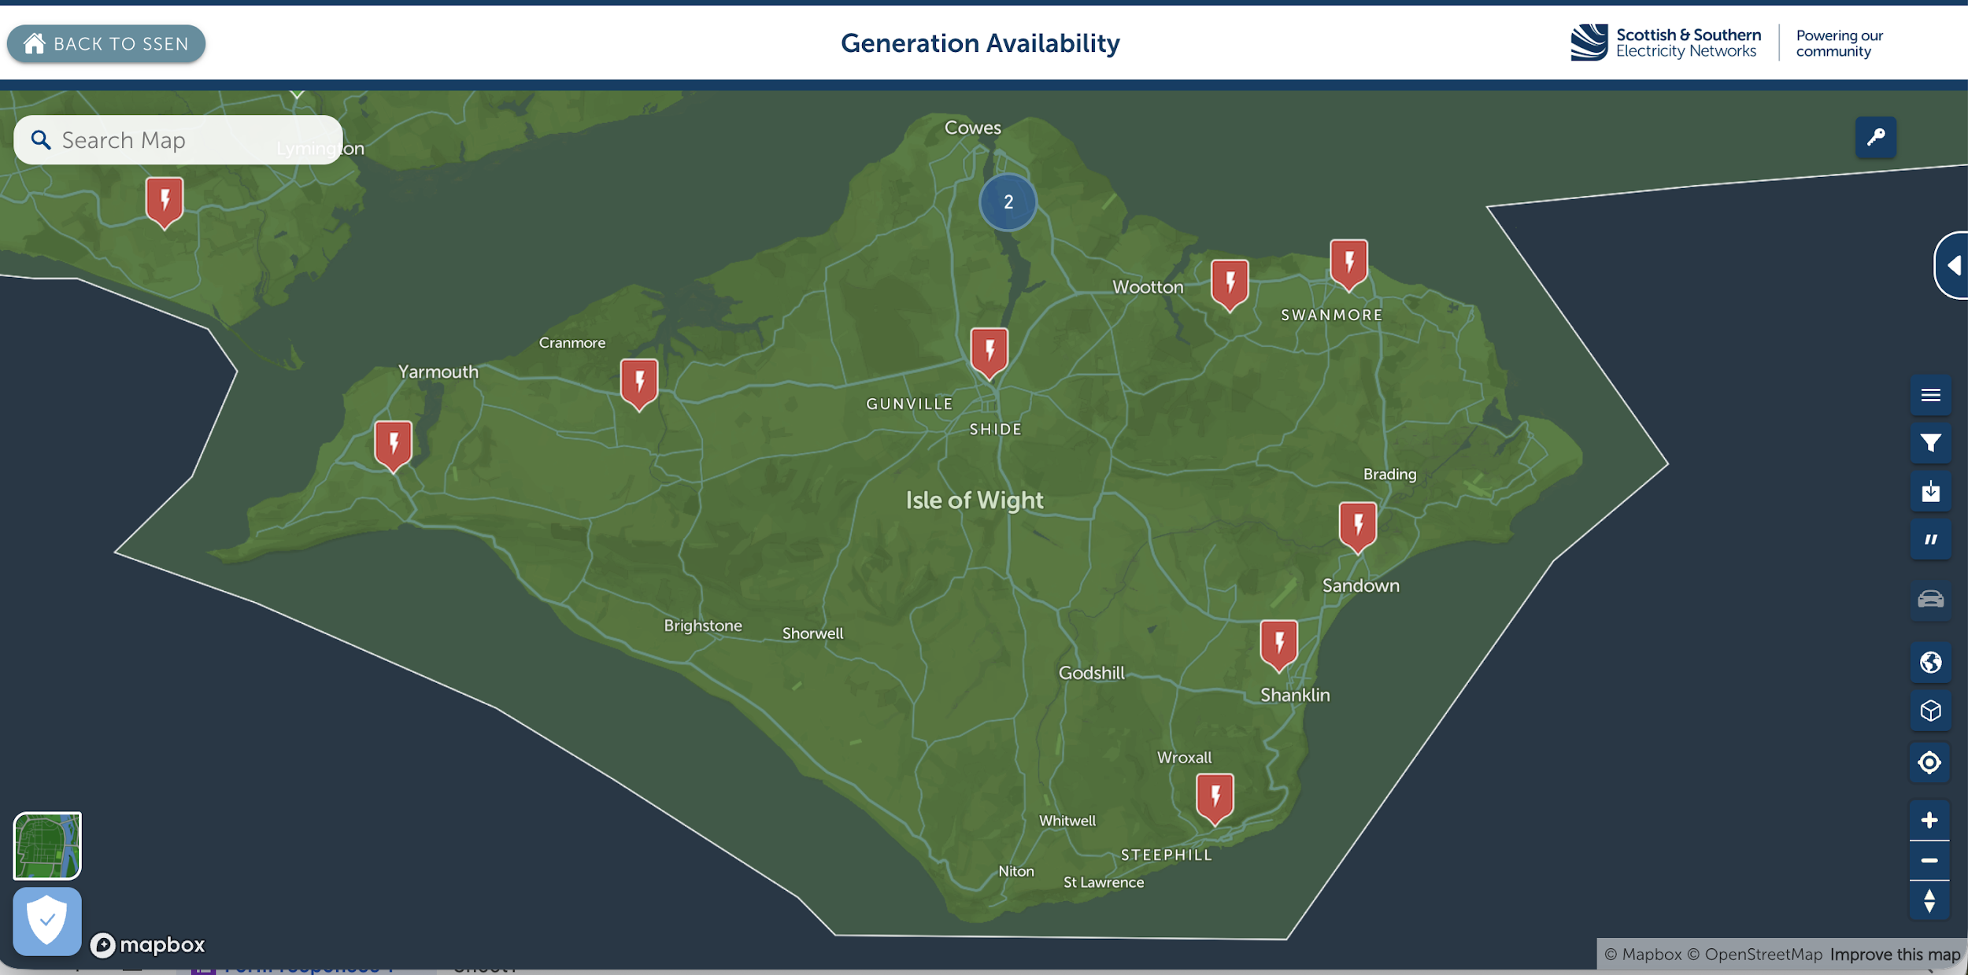
Grid capacity: a quick view
Source: SSEN “Generation Availability / Network Capacity” map (screenshot)
Notes:
LISA
[Sources]
- SSEN network maps (Generation Availability / Network Capacity): https://network-maps.ssen.co.uk/
[/Sources]

Slide 7


Fuel poverty: a quick snapshot
South East of England
Isle of Wight
9.65%
13.13%
DESNZ Sub-regional fuel poverty data
DESNZ Sub-regional fuel poverty data
Different sources use different definitions — but the message is clear: too many households are struggling with energy costs.
Notes:
PHOEBE
Wider estimates based on 10% of household income put the level at 30% but these figures are the DESNZ figures based on the governments quite narrow definition.

Slide 8


There are also social challenges
01
02
03
04
We have an ageing
population
Lower than average
incomes
We are one of the most
“left behind” areas
in the UK
We are an island with
limited power connections
Notes:
On the Island we have some specific problems – over 35% of our population is over 65, lower than average incomes, over 25% of secondary school students were excluded from school at some point last year and we have limited infrastructure, we only have 3 cables connecting us to the mainland and at times these are already at capacity. This creates a perfect storm for fuel poverty. 40% of the Island is not connected to the gas grid.

Slide 9
So, what is the solution?

Slide 10
What is “Power Together”?
A network of home batteries that work together — like one shared community battery.
Batteries in homes
Smart control
Works as one
Benefit
Installed in multiple homes across the Island.
Software controls charging and discharging.
Together they can act like a bigger system.
Savings and value are shared locally.
One big battery owned by a large company
100–200 smaller batteries hosted in homes and community buildings.
Notes:
First, batteries are installed in homes and community buildings across the Island. They are locally hosted, and community-owned….this means the benefits stay within the community.
Software manages when those batteries charge and discharge, providing flexibility by responding to prices and grid needs.
Because they are coordinated, the batteries can then work as one. From the grid’s point of view, they act like a single, larger battery, enabled through aggregation.
The benefit of this is that savings and value are created and, crucially, shared locally, supporting households and wider community outcomes.
This also overcomes the problems of needing a large grid connection, space and planning permission for a large battery.
Power Together is about keeping ownership and value within the community. Instead of a single large battery owned by a large company, we have lots of smaller batteries owned by island people.

Slide 11


Slide 12
How Power Together helps
Three simple outcomes
Lower bills
Warmer homes
Community benefits
Use stored electricity at the most expensive times — so you buy less at peak prices.
Making energy cheaper helps people heat their homes more confidently.
Any surplus can support local action: advice, upgrades, and future projects.
Notes:
Lower energy bills
More protection from price rises
Some backup power resilience
Warmer Homes - This has a massive impact on both mental and physical health, just being able to wake up in a warm home or not have to play "penguins" when you go to bed makes a huge difference to peoples lives.
We will give priority support for those struggling with bills
Any surplus is reinvested back in the community
BUT one of the biggest benefits is that the householder won’t need to configure anything or make any decisions as to the best time to charge or discharge the battery, it will be controlled through software to make sure it is generating the most benefit for the householder and community.

Slide 13
Who can take part?
We’re designing it to work for different households and buildings
Households
Community buildings
Small businesses
Home batteries where suitable, with support to make it easy to join.
Batteries in shared spaces can help spread benefits locally.
Some businesses can join too — helping the project grow and earn more.
Notes:
Support for households – no tricky apps to try and use
Community buildings – spread the benefits locally
Small businesses – many are owner/occupier style businesses who can help the project grow and earn more.

Slide 14
How the project earns income
Think of it as a few simple “building blocks” that add up:
Using cheaper electricity
Charge when electricity is cheaper, use it later.
Helping balance the national system
Provide quick support when the system needs it.
Supporting the local network
Soak up extra solar and ease busy periods.
Future value
New opportunities as markets and services develop.
Notes:
If we think of our revenue model as a stack of building blocks.
The first "block" is by charging the battery when energy is cheap and then using it when energy is more expensive.
We can also help balance the national system and provide quick support when it is needed.
We can support the local system by soaking up extra solar and easing demand during busy periods
And then there is future value, we are going through an era of rapid change new opportunities and markets are constantly developing.

Slide 15
How this helps our grid
Before
After
Solar can exceed local grid capacity
Evening demand strains the network
Upgrades are slow and expensive
Excess solar stored locally
Stored energy supports peak demand
Pressure reduced without waiting for major upgrades
Notes:
If we look at a before and after, from the grid’s point of view.
Before, local renewable generation can exceed available network capacity, and peak demand in the evenings puts additional strain on already constrained parts of the grid. This can limit new connections and further local generation, with network reinforcement often the only option, which is time-consuming and costly.
After, with the Power Together model, electricity is stored locally and released at the right times. This provides flexibility that helps manage peaks, ease constraints, and make better use of existing capacity.
In practice, this supports the grid by deferring reinforcement where possible, improving overall system resilience, and opening up opportunities for additional connections and local generation.”

Slide 16
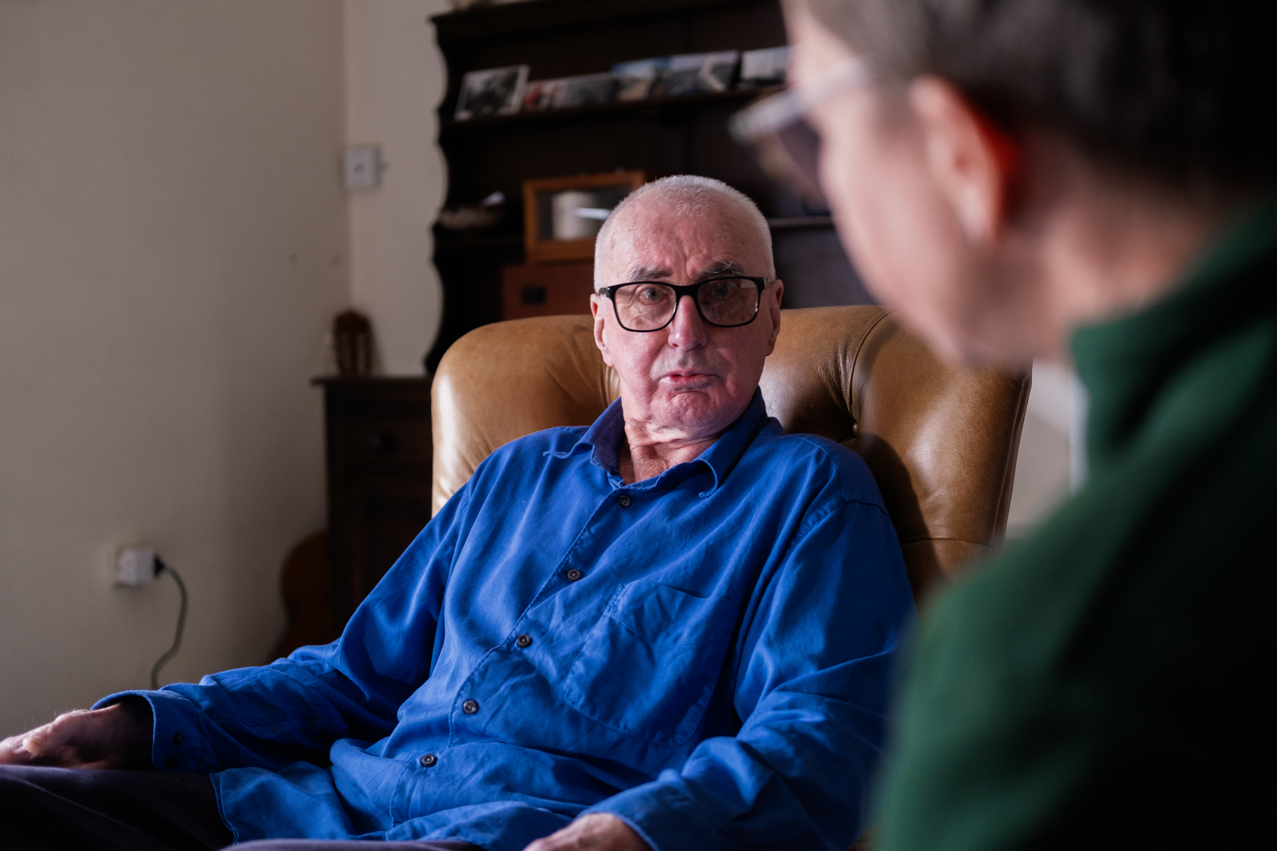
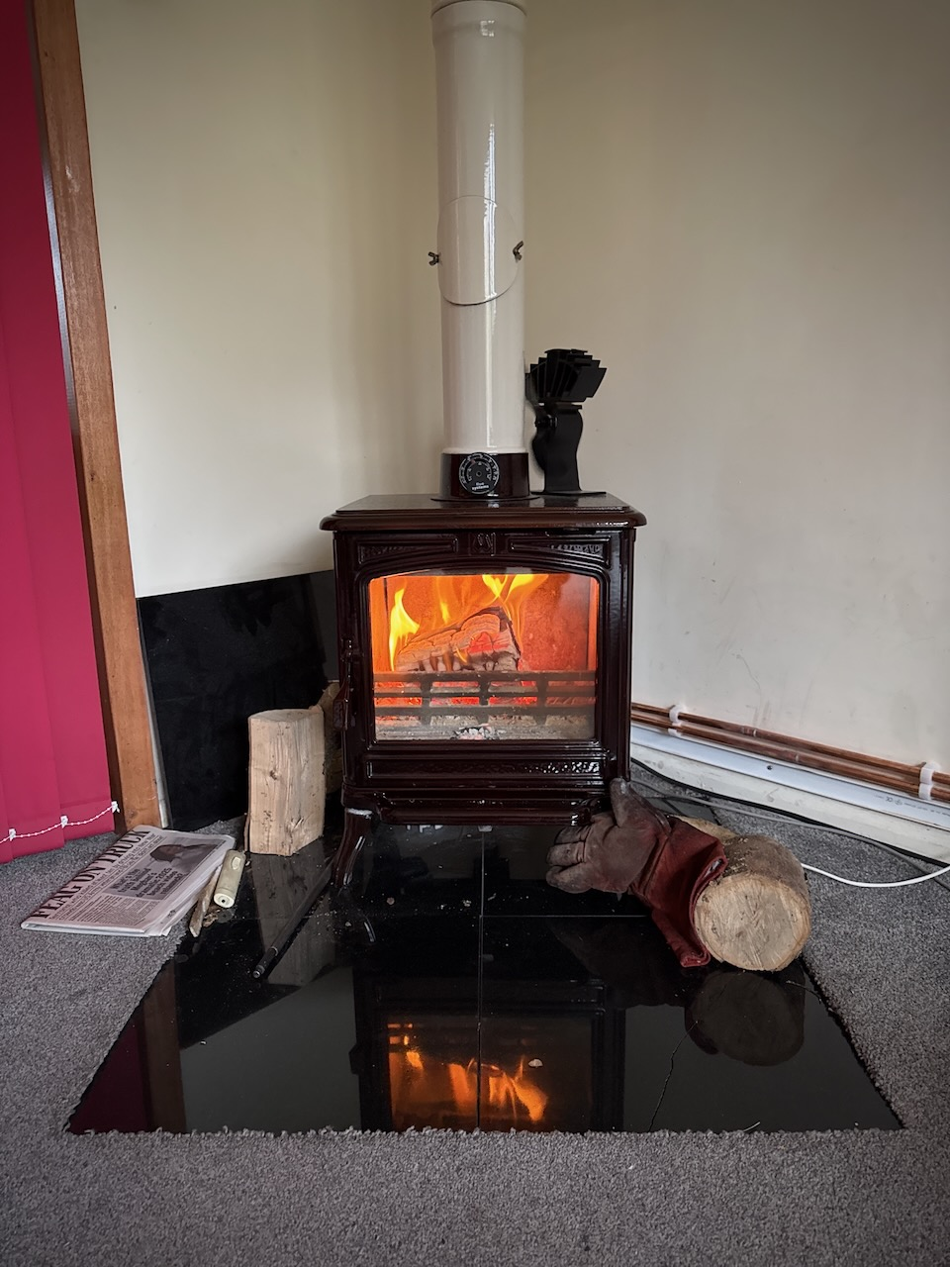
Notes:
But at the heart of this is people. We want people to be able to afford to heat their homes adequately.
We want to increase the resilience of the Island by reducing the impact of power cuts with backup power available in homes during outages.
We want clean , cheap local energy to be available for local people, with less reliance on centralised systems.
But above all else we want to make this transition fair for everyone, not just those who can afford it.

Slide 17
Any questions?

