Slide 1
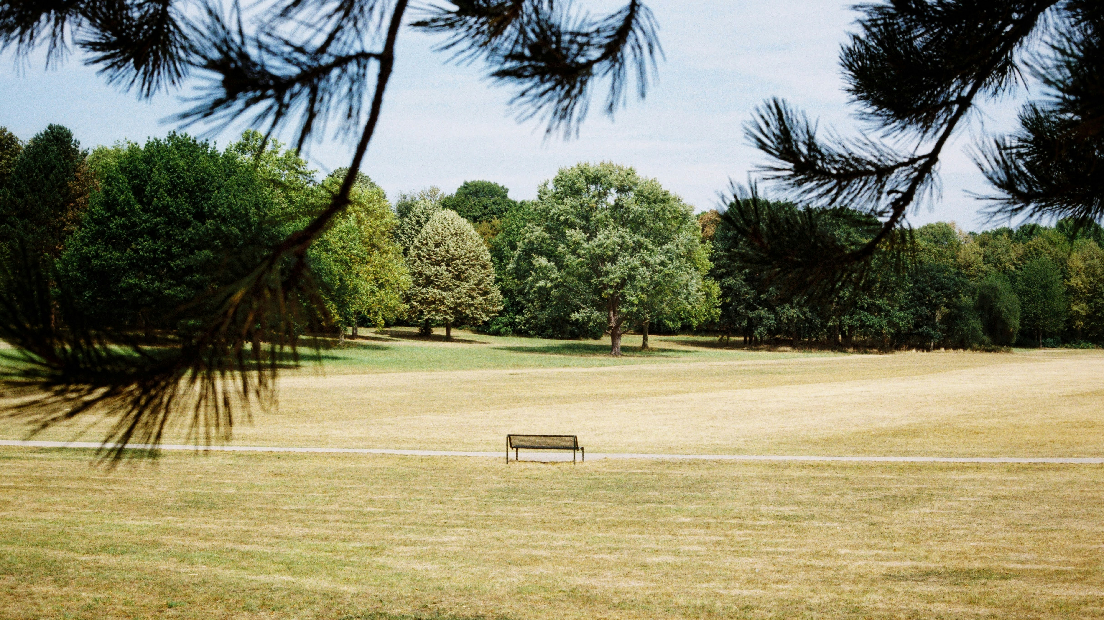
TOO HOT
Photo by Chris Weiher on Unsplash

Slide 2
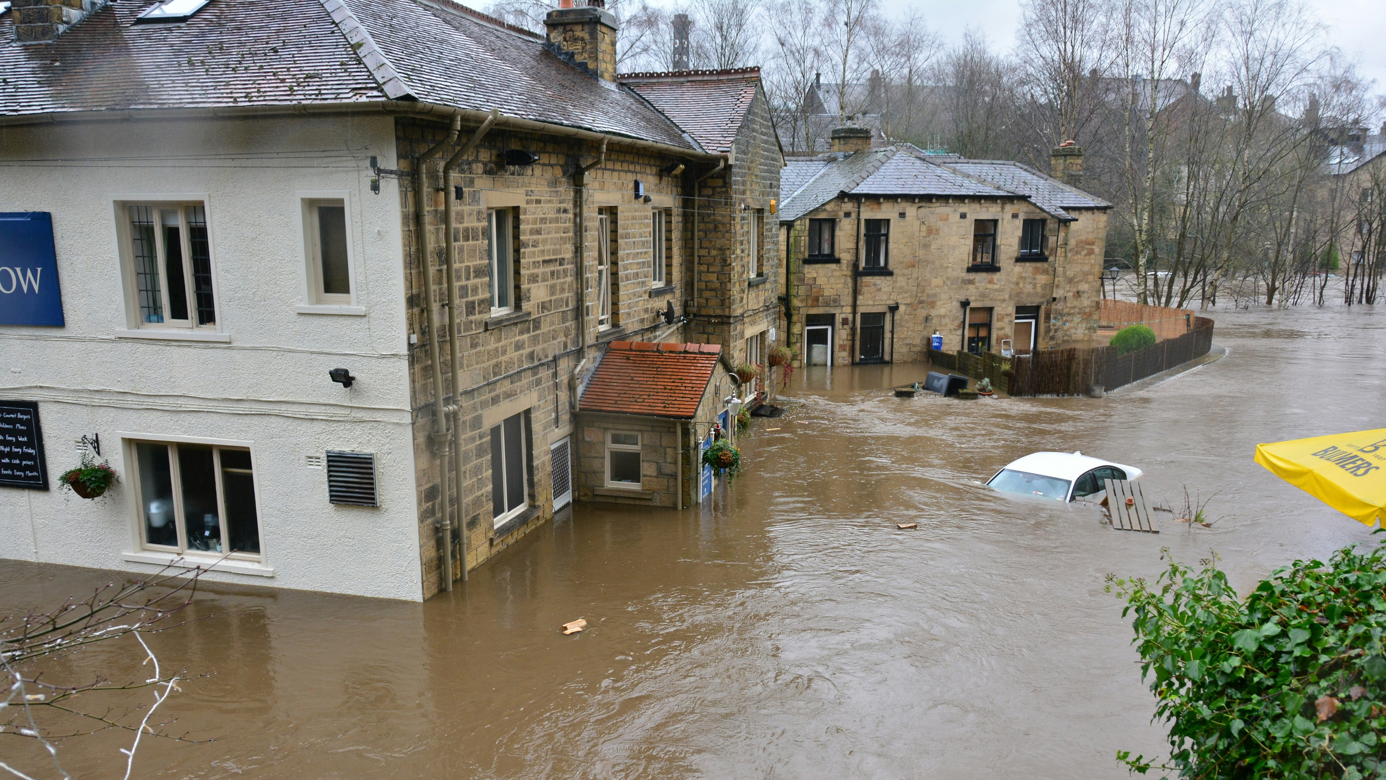
Photo by Chris Gallagher on Unsplash
TOO WET

Slide 3
Topics from the National Emergency Briefing
Nature – we’ve lost 53% of our biodiversity
Climate - if we keep burning fossil fuels, temperatures will keep rising
Weather extremes – the UK is getting wetter in winter, and faster than models predicted
Tipping points - the biggest risk is the failure of the ocean current that keeps the UK’s climate mild
Food security - the UK imports 40–50% of its food, much from climate-stressed regions like the Mediterranean
Health - the real killer is the breakdown of our systems
National security - the greatest risk is cascading crises overwhelming government systems and eroding democratic stability
Economics - clinging to the status quo delays change and increases risk
Energy transition - around half of UK recessions since 1970 have been triggered by fossil fuel price volatility

Slide 4
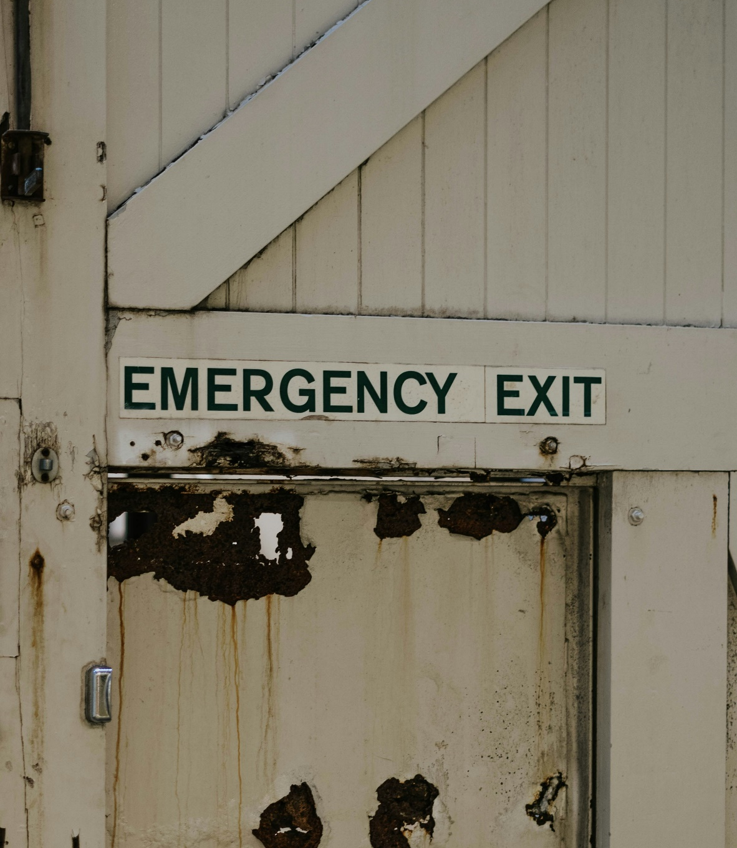
Failing to plan is planning to fail…
We know our local geography and local people
We can work with locals to define the risks and opportunities
Resilience forums can advise, but no-one else can do the actual planning
And there’s no escape either…

Slide 5

Key stages in a community emergency plan
Set up a community emergency group
Risk assessment
  Impact on the community e.g. from a heatwave
  What can we prepare in advance?
  How do we respond when it happens?
  What about recovery afterwards?
Assess local skills and resources
Key locations for use as places of safety
Emergency contact list (communications?)
Local organisations that can help
Share with the emergency services
WHO ARE THE
MOST VULNERABLE
IN OUR COMMUNITY?

Slide 6
Example – Hot Weather and Heatwaves https://prepare.campaign.gov.uk/be-informed-about-hazards/hot-weather/
Impact on community | How can we prepare? | Action in emergency
Increased risks of overheating, dehydration, heat exhaustion and heatstroke Disruption to essential services, including power cuts, water restriction, and transport disruption Higher risk of wildfire | Disseminate clear guidance on the symptoms of heat exhaustion and heatstroke, and how to respond Promote simple heat-protection measures (hydration, shading, ventilation, cooling rooms) Work with local facilities (libraries, community centres) to identify potential “cool spaces” | Activate the heatwave communication network and issue local alerts Direct people to nearby cool spaces and support access to them Coordinate volunteers to deliver water or provide practical support

Slide 7
There is more heatwave detail on the Knowledgebase
Check weather and travel warnings
Check your building’s heating is turned off
Check that fridges, freezers and fans are working properly.
Ensure that family, friends and neighbours who may be at higher risk of becoming unwell are aware of, and following, actions to keep themselves safe.
Drink plenty of fluids. If you are going out, take a refillable bottle filled with water
Keep out of the sun between 11am and 3pm when UV levels are highest - within a cool building if possible
Schedule physical activities (e.g., exercise, walking the dog) for times of the day when it is cooler, such as the morning or evening.
Keep your home cool by shading and closing windows and curtains, especially in rooms that face the sun, and opening windows when the air feels cooler (e.g., at night).

Slide 8
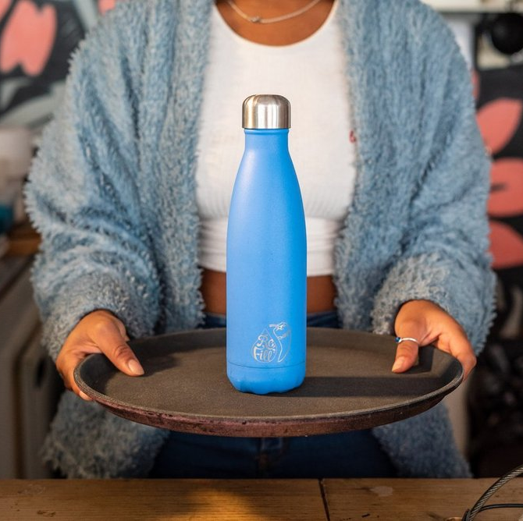
Refill destinations
Refill Destinations are forward-thinking
councils, universities and businesses
that are committed to transforming their
local area for residents and tourists alike.
Refill Destinations are working to power refill and reuse in towns and cities across the UK, reducing plastic waste, meeting their climate action targets and providing greater access to free drinking water in their local area.
Click here to see how Manchester is powering a Refill Revolution or click https://www.refill.org.uk/contact to make contact about becoming a Refill Destination.

Slide 9
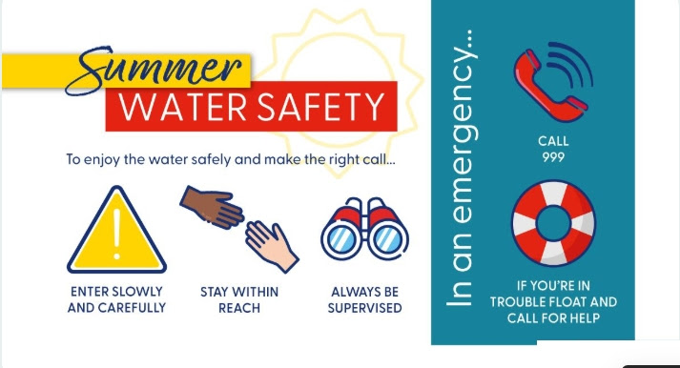
Cold Water Shock
Stages in shock are hyperventilation, high blood pressure, and ultimately “swim failure”
as muscles cool. 47% of UK accidental drownings occur between May and August
Safety advice says don’t jump straight into unknown water
Enter gradually, wearing protective and visible gear if possible.
If you get into difficulties, don’t thrash around but float on the surface until your breathing recovers, and call for help.
If you see someone in difficulties, don’t jump in yourself but throw them something that floats
Never go wild swimming on your own.

Slide 10
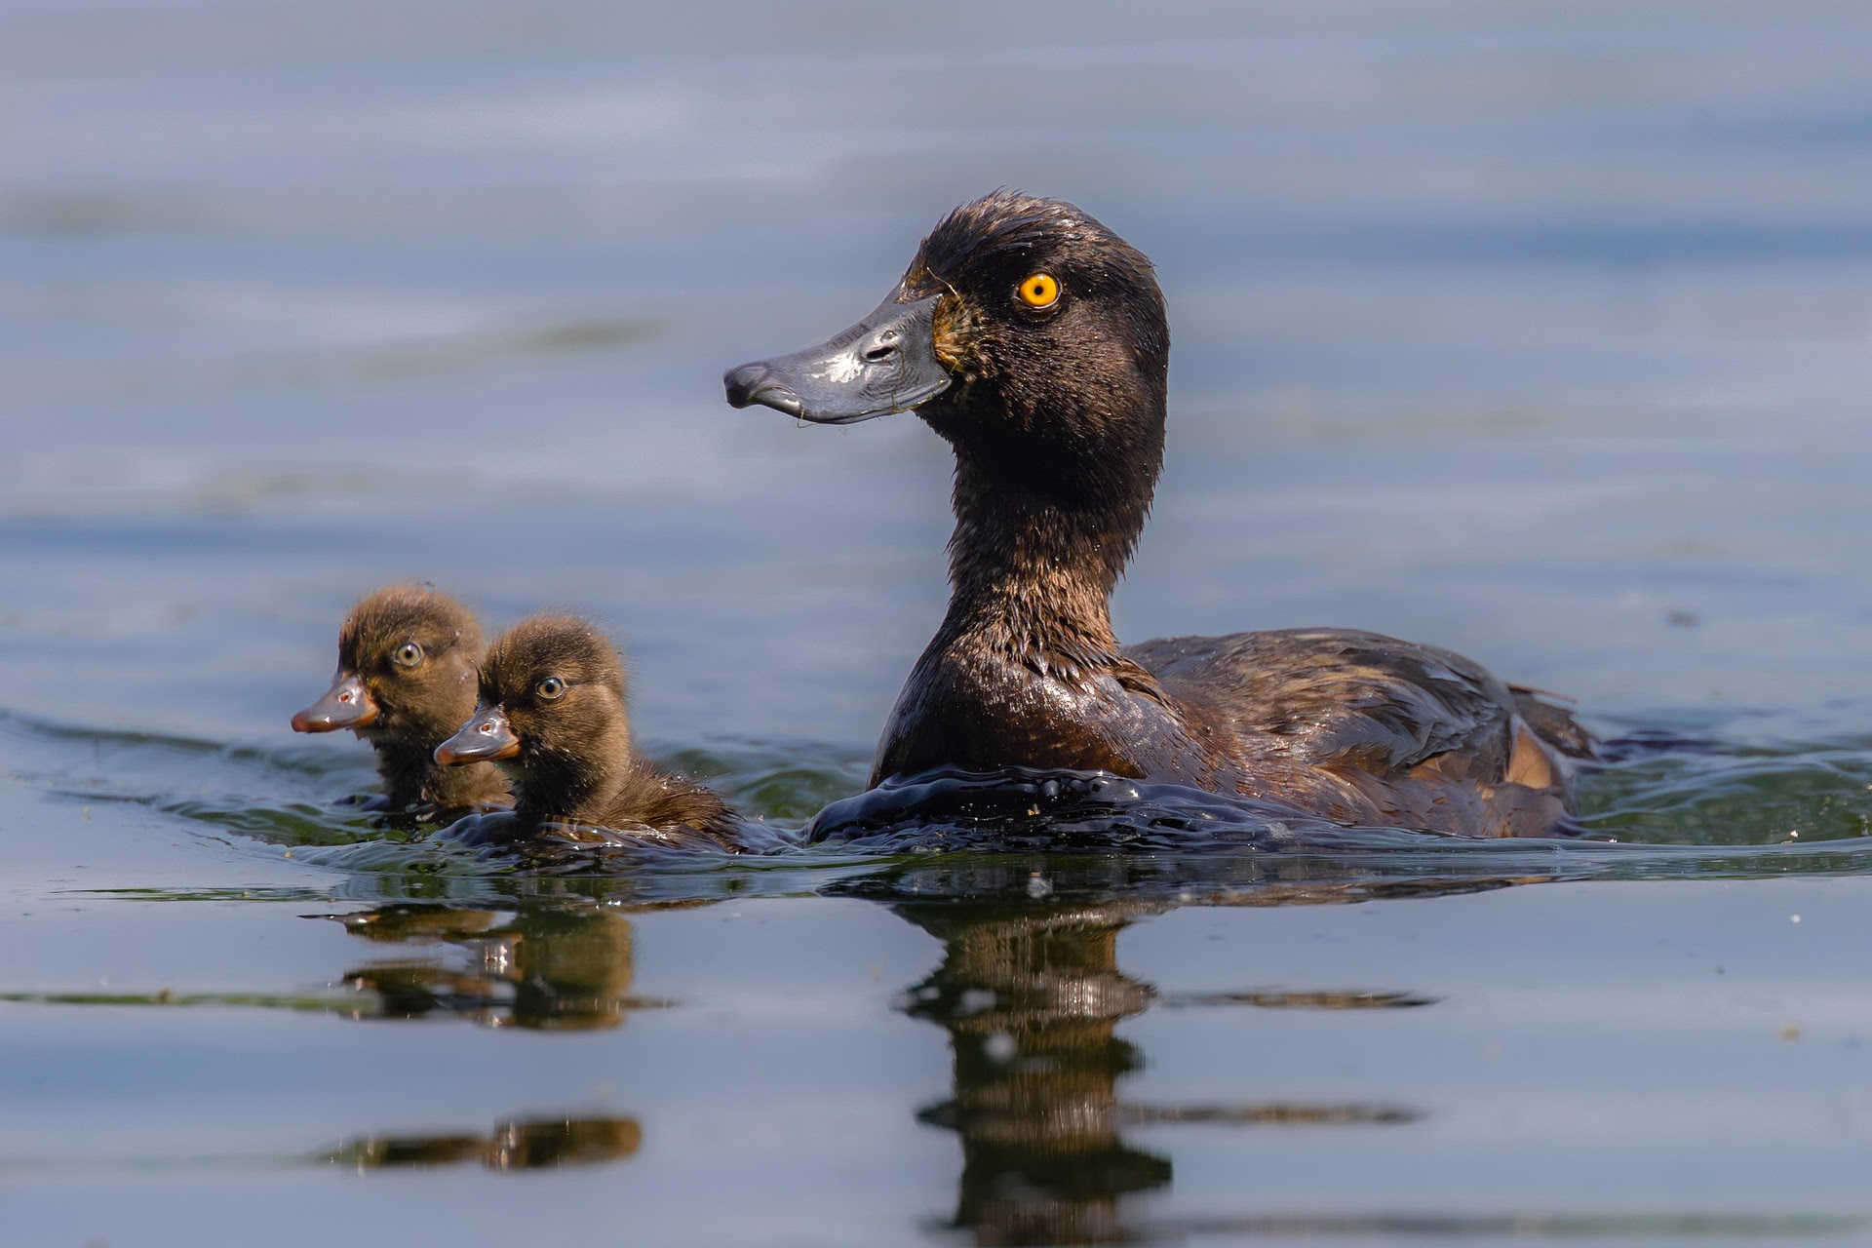
And wildlife can also suffer from heatwaves…
The WWF and Treedom have published advice on how we can support wildlife during heatwaves, including:
Provide water
Create shade
Offer food
Plant native plants
Avoid disturbing nests
Local wildlife do not need to be disturbed
by people jumping into their homes!
Be aware of wildlife in streams, lakes and
rivers, and follow any warning signs.
And don’t forget water and shade
for your pets – Blue Cross advice

Slide 11
There is wider topic coverage in the (quiet)
UK Government’s Prepare campaign
Animal and plant health
Antimicrobial resistance
Cold weather, snow and ice
Cyber
Droughts
Fires in the home
Flooding
Hazardous substance and radiation exposure
Hot weather and heatwaves
Infectious disease outbreaks
Overseas emergencies
Phone and broadband outages
Poor air quality and pollution
Power cuts
Storms
Terrorism
Water supply interruptions or outages
Wildfires
BUT NOT FOOD SUPPLY! CHECK OUT SUSTAINABLE FOOD PLACES

Slide 12
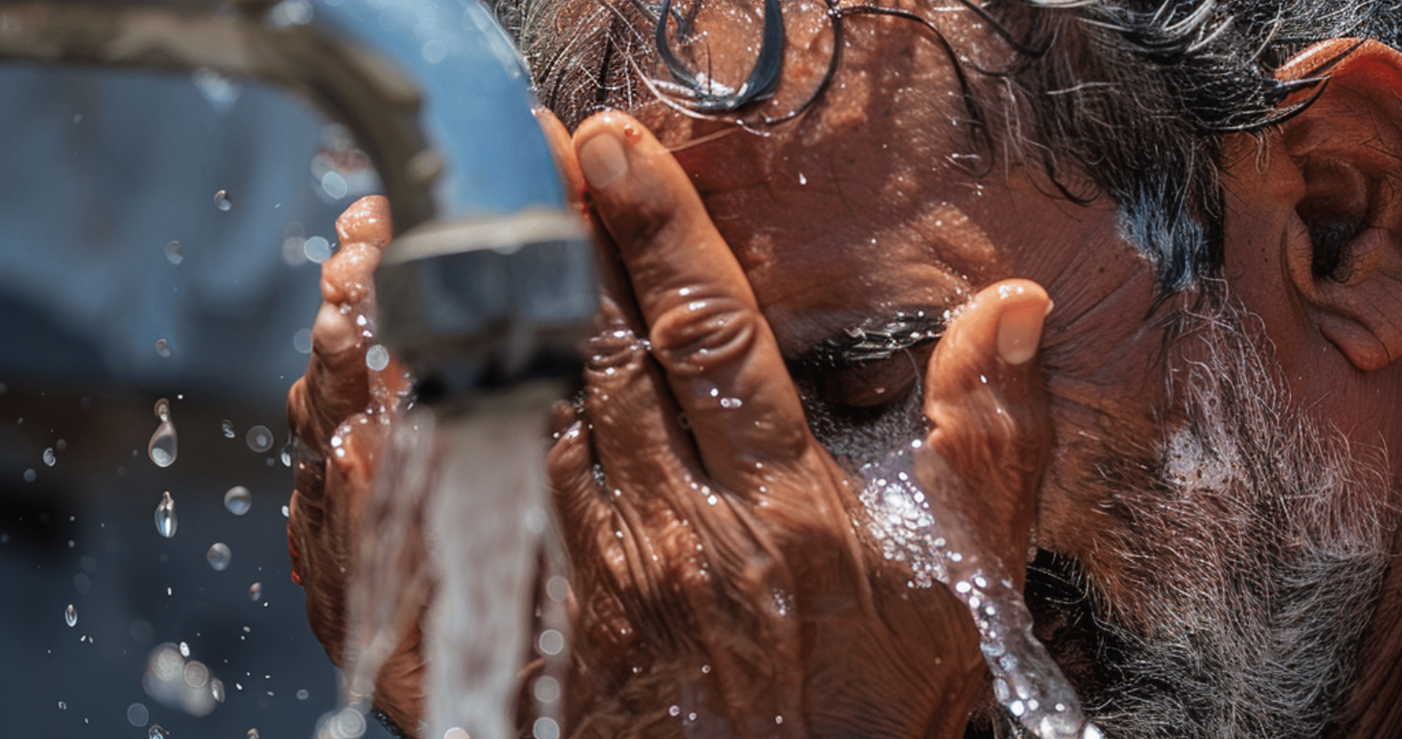
Image by Graphix Made from Pixabay

