Slide 1


















CLIMATE CHANGE CHALLENGES
from a younger generation’s perspective
Presented by: Chih-Hsuan, Chang
  Date: 30 September, 2026

Slide 2

Introduction
  Physical Climate Challenges
  The Awareness and Engagement Challenges
  The Implementation and Action Challenges
02

Slide 3




PHYSICAL CLIMATE CHALLENGES
WHAT ARE WE FACING?
03

Slide 4
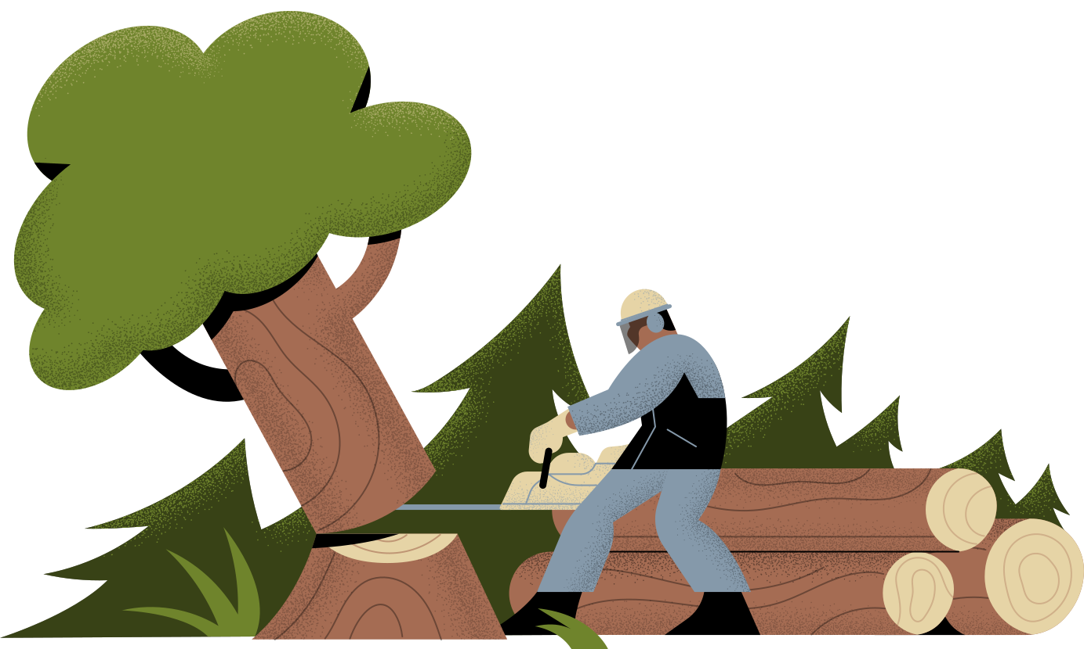
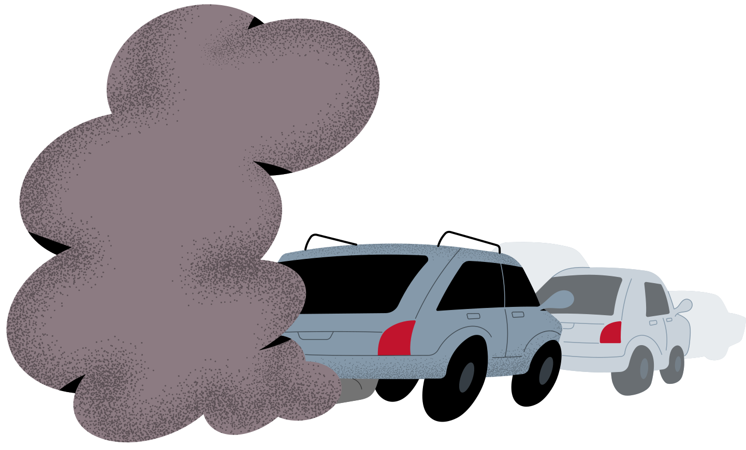

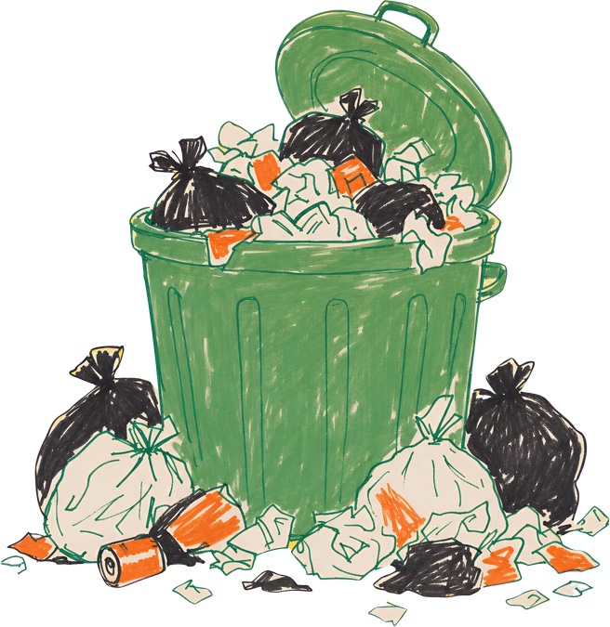
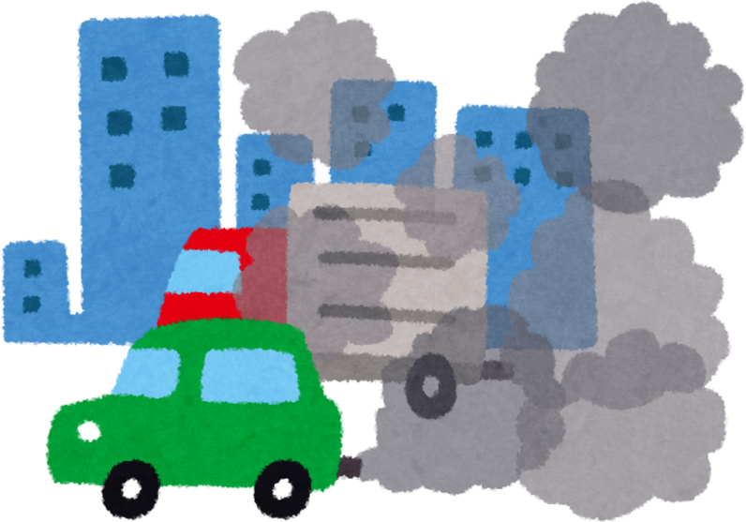
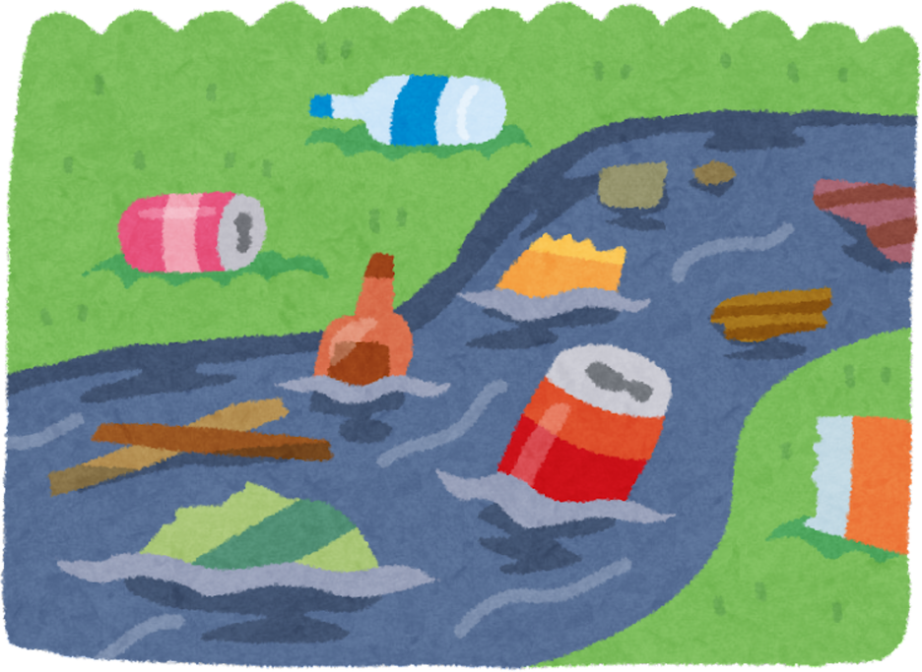
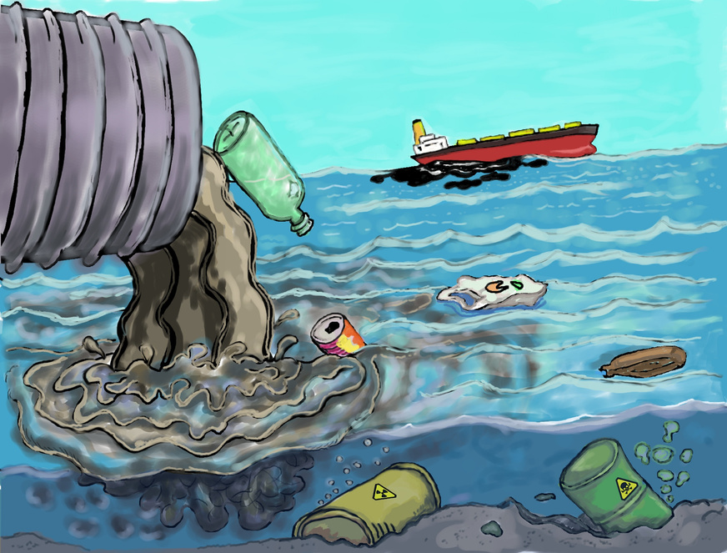
Human activities are putting pressure on the planet
04

Slide 5

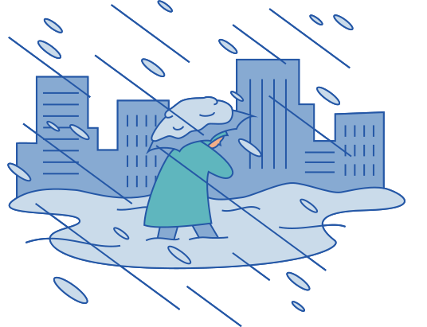
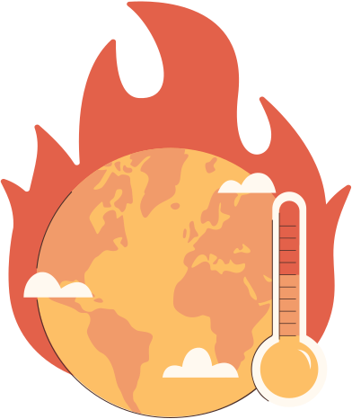
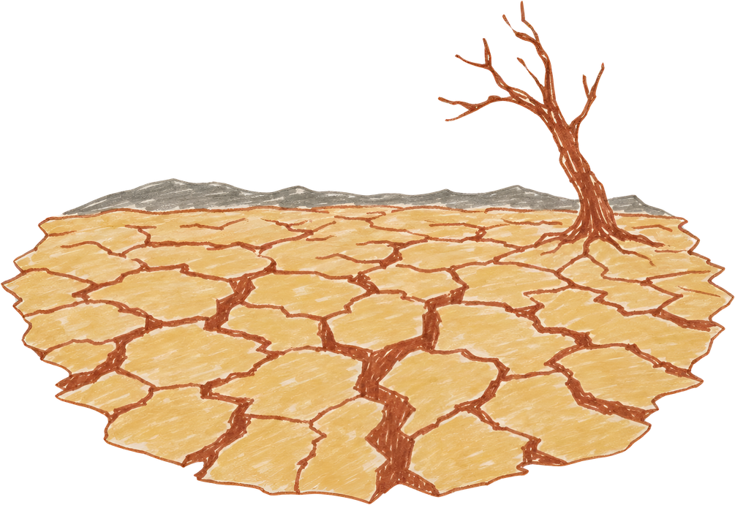
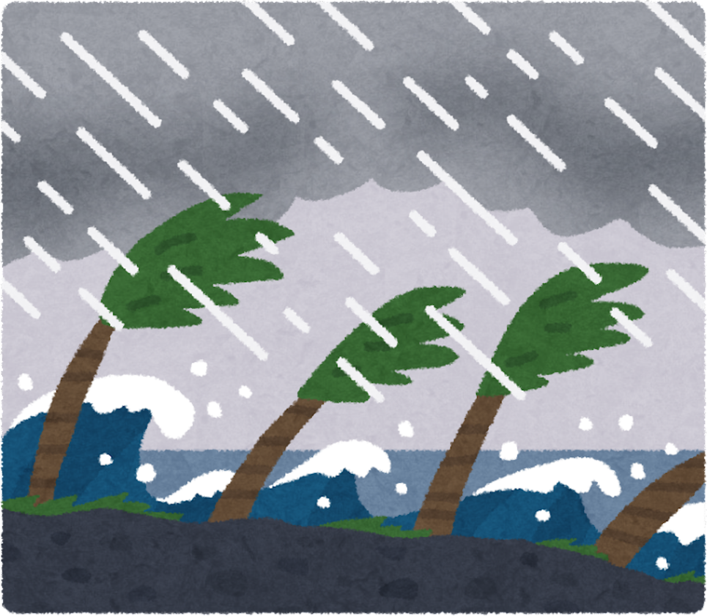
One major consequence is a changing climate,
with more extreme and disruptive weather
flooding
wildfire
drought/ extreme heat
Global Warming
severe storms
05

Slide 6
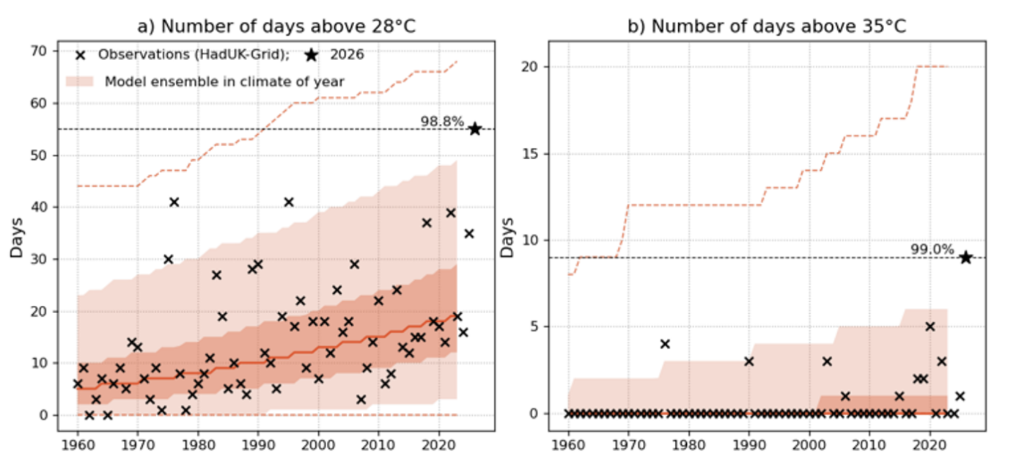
heatwaves are becoming more frequent and more persistent
  The UK recorded 55 days above 28°C and 9 days above 35°C in summer 2026.
How exceptional were UK summer 2026 daily temperatures? - Met Office
06

Slide 7
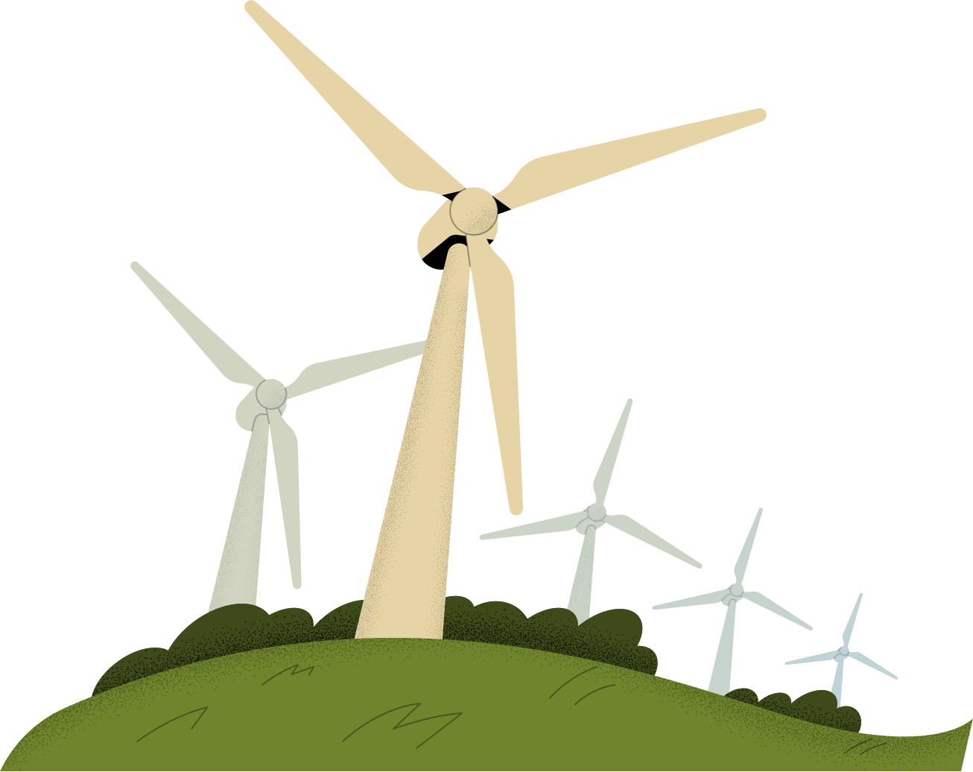
The Awareness and Engagement Challenges
How do people notice, understand and engage with climate change?
07

Slide 8
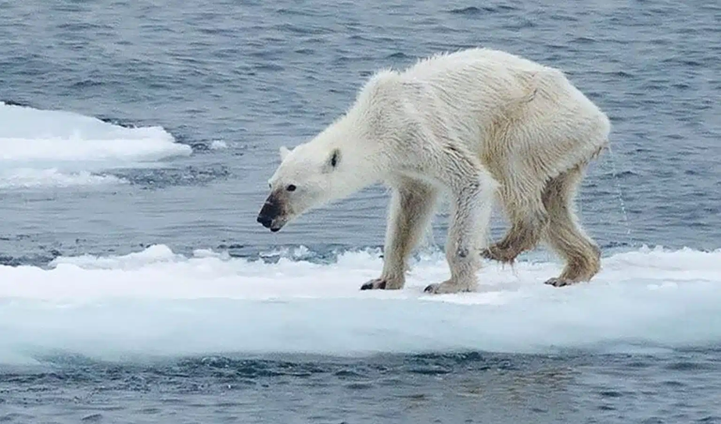
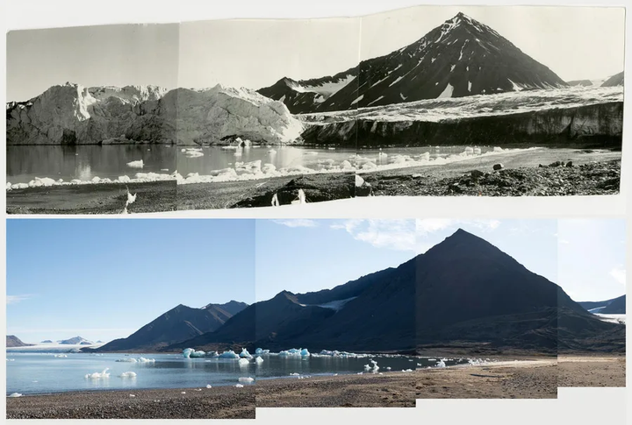
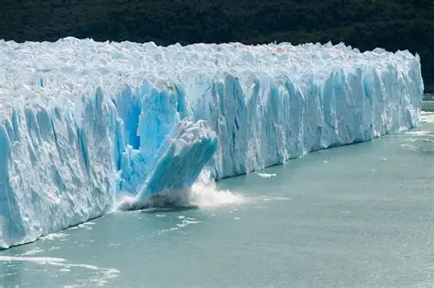
How did people become aware of climate change?
  For many years, climate change was represented through powerful images and documentaries such as Melting Greenland
retreating glaciers
melting ice
They made climate change visible,
even when its impacts felt far removed from everyday life
08

Slide 9
When climate change becomes part of everyday life
  Heatwaves, flooding, extreme rainfall and seasonal disruption are increasingly shaping everyday conditions
They made climate change tangible,
as people began to experience its impacts in everyday life
09

Slide 10
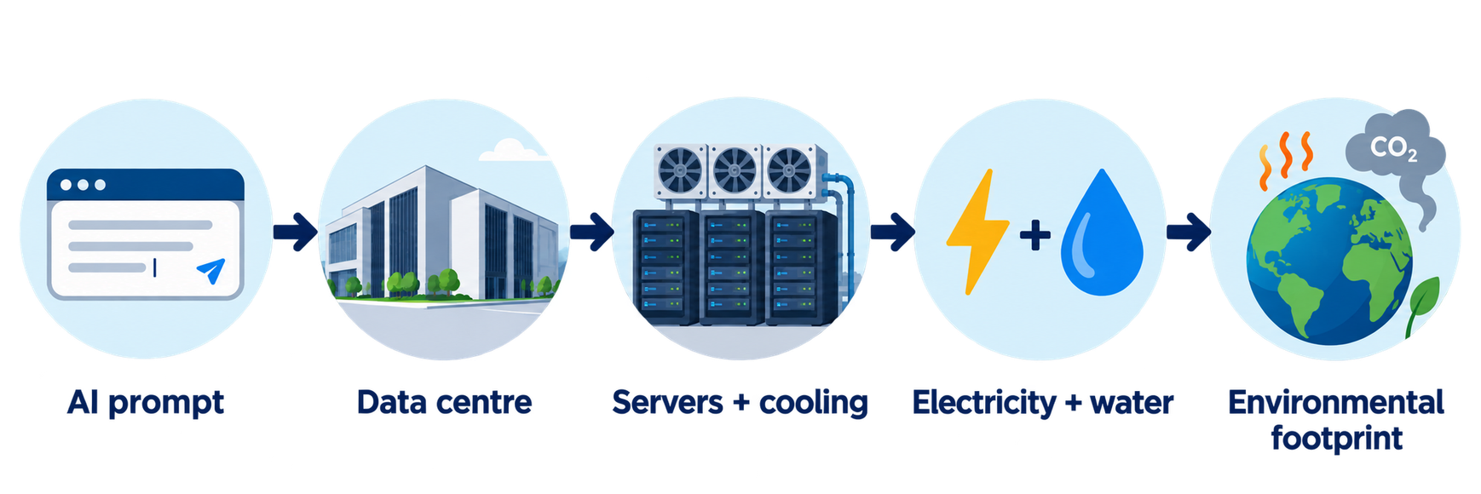
What if the environmental impact is invisible?
  AI feels virtual, but its environmental footprint is physical
  Global data-centre electricity demand is projected to nearly double from about 485 TWh in 2025 to around 950 TWh by 2030, with AI a major driver of growth
Key Questions on Energy and AI – Analysis - IEA
Invisible impacts can be easy to overlook,
even when the activity itself is part of everyday life
10
Notes:
When environmental impacts are not immediately visible, raising awareness becomes an important first step towards action.

Slide 11

WHAT TURNS AWARENESS INTO ENGAGEMENT?
Awareness may attract attention, but engagement depends on whether people feel that the issue is understandable, relevant and worth responding to
11

Slide 12

Can people easily understand what the problem is?
  visual storytelling
  clear examples
Understandable
Does the issue feel connected to their own lives?
  polar bears / Greenland = distant
  heatwaves / flooding = experienced
  AI / data centres = everyday use but hidden environmental link
Relevant
Do people feel paying attention or becoming involved is worthwhile?
  does the message create a sense of concern?
  does it feel hopeless or manageable?
Worth responding to
12

Slide 13
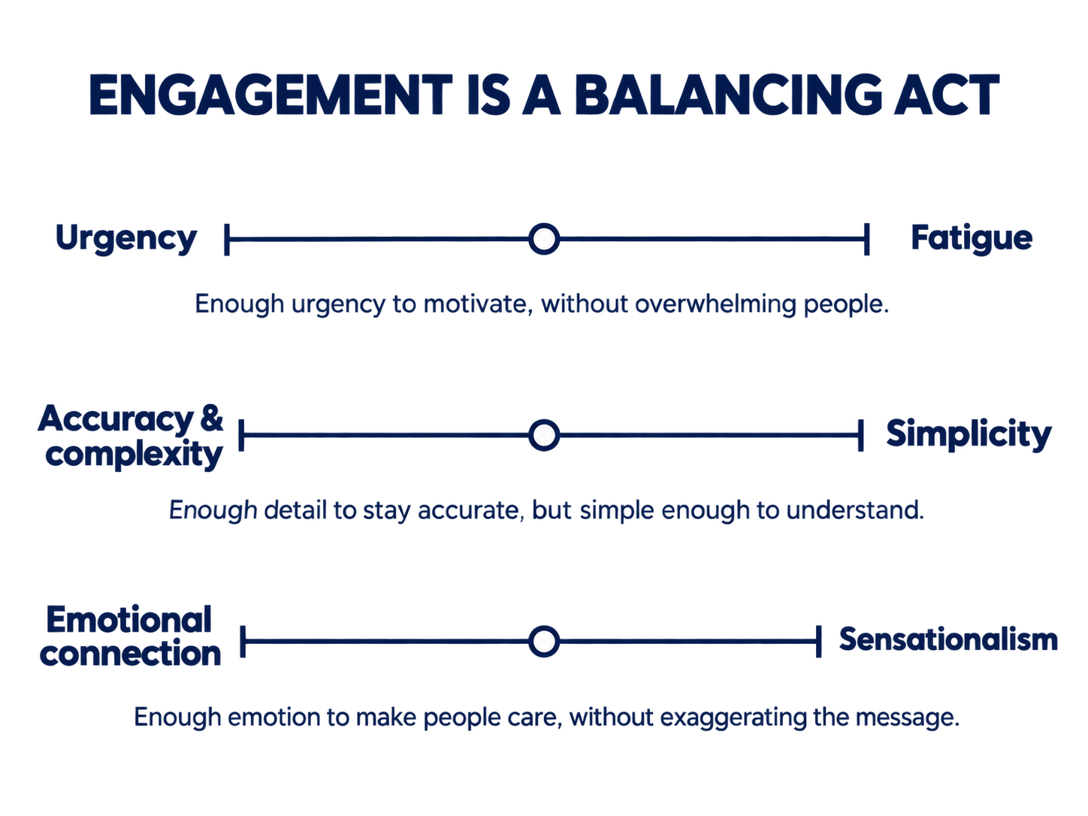

COMMUNICATING FOR ENGAGEMENT IS A BALANCING ACT
13

Slide 14


The Implementation and Action Challenge
What turns engagement into meaningful change?
14

Slide 15
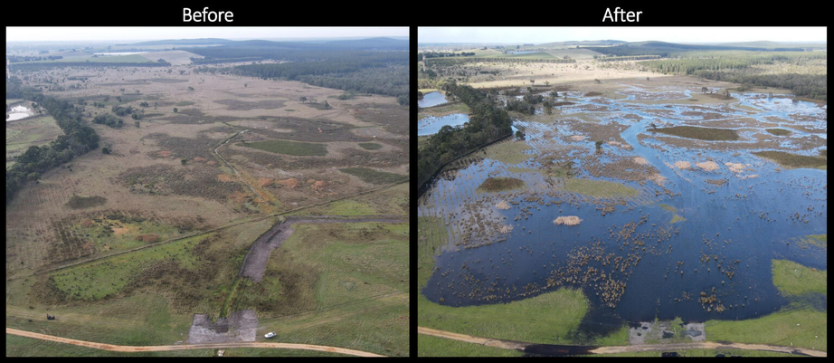
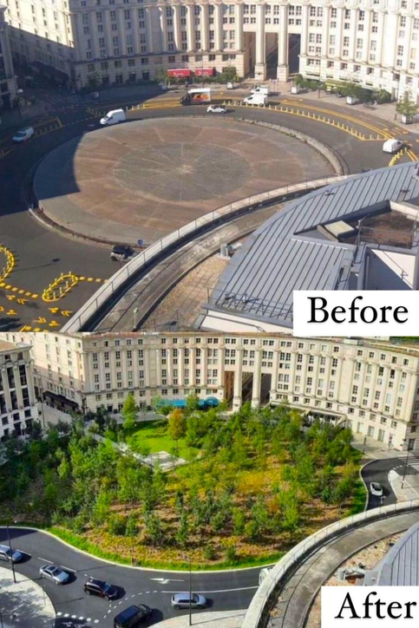
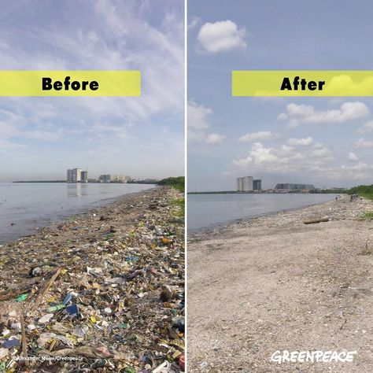
WHEN CHANGE BECOMES VISIBLE
  Visible results can make action feel more achievable and worthwhile
15

Slide 16
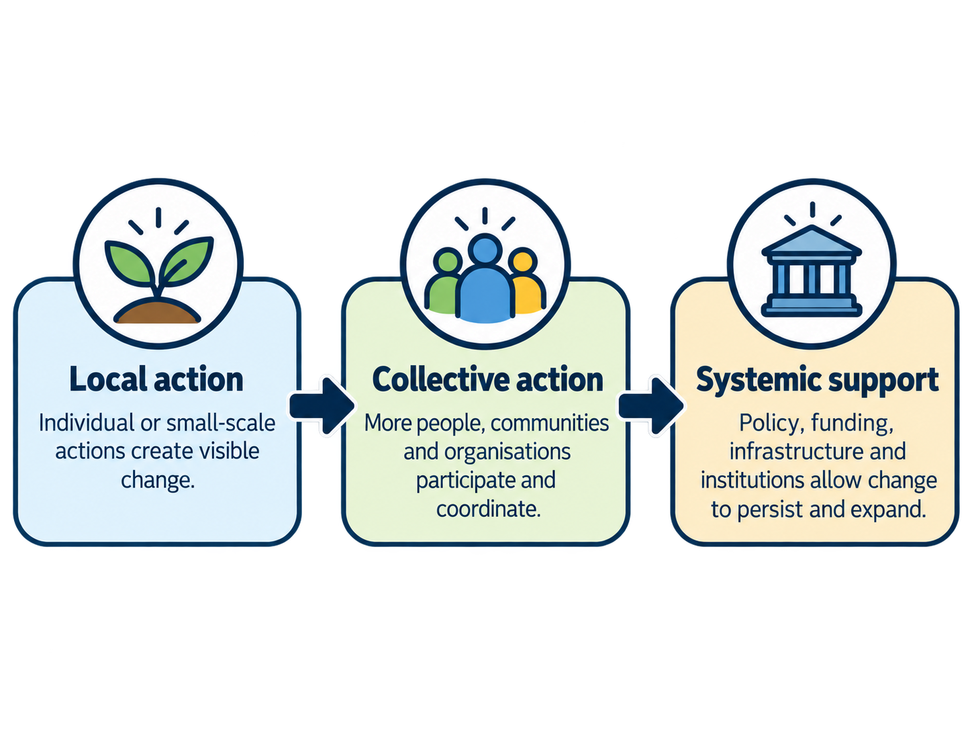
HOW CAN ACTION SCALE?
  Traditionally, scaling is often understood as a bottom-up process, where local action grows through collective participation and institutional support
16

Slide 17
A NEW ROUTE TO SCALE?
  Digital platforms can allow individuals and influencers to reach audiences far beyond those reached by many local organisations
Influencers may be able to mobilise attention or participation very quickly,
but implementing lasting change still depends on infrastructure, funding and institutions
17
Notes:
A recent Nature Climate Change Perspective looked at how social influence shapes climate attitudes and action. It argues that influence can come from different actors, including close social contacts, everyday influencers, high-profile influencers, companies and NGOs, and can operate through conversations, digital platforms, mass media and social norms.
What I find particularly interesting is that digital platforms can now allow individuals or influencers to reach audiences far beyond the scale of many traditional local organisations.
This can rapidly shape attention, social norms and participation, although reach is not the same as institutional capacity or lasting impact

Slide 18
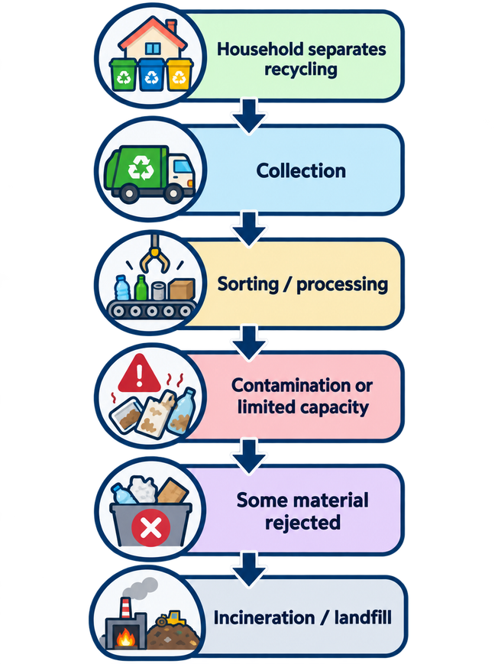
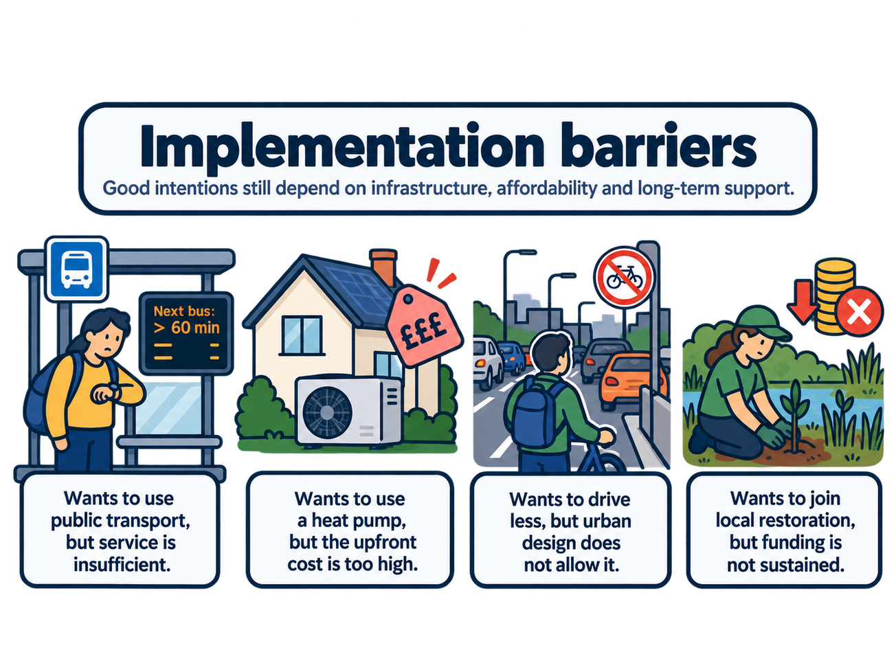
THE IMPLEMENTATION GAP
  Taking the “right” action does not always guarantee the intended outcome, and good intentions do not always translate into action.
▼ When good intentions face practical barriers
When action does not produce the intended outcome ▶
18
Notes:
Before action, people may be constrained by infrastructure, affordability or funding.
And even after people take the intended action, the system that receives that action can still affect the final outcome.

Slide 19
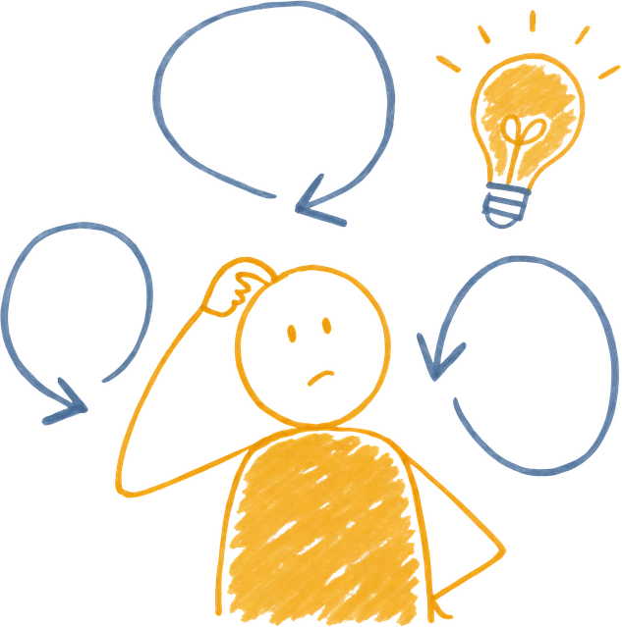

FROM CHALLENGE TO CHANGE
The physical challenge
What are we facing?
Climate impacts are becoming more frequent, disruptive and increasingly part of everyday life
The awareness and engagement challenge
Do people recognise and stay engaged with it?
Impacts may be distant, directly experienced or difficult to see, and how they are communicated shapes whether people remain engaged
The action and implementation challenge
How does concern become meaningful change?
Individual action matters, but lasting impact also depends on social influence, infrastructure, affordability, funding and institutional capacity
19
Notes:
We often talk about climate change as a physical challenge, but what I have tried to show today is that awareness, engagement and implementation are challenges in themselves. So I would be interested to hear where you think the biggest gap is today.

