Slide 1
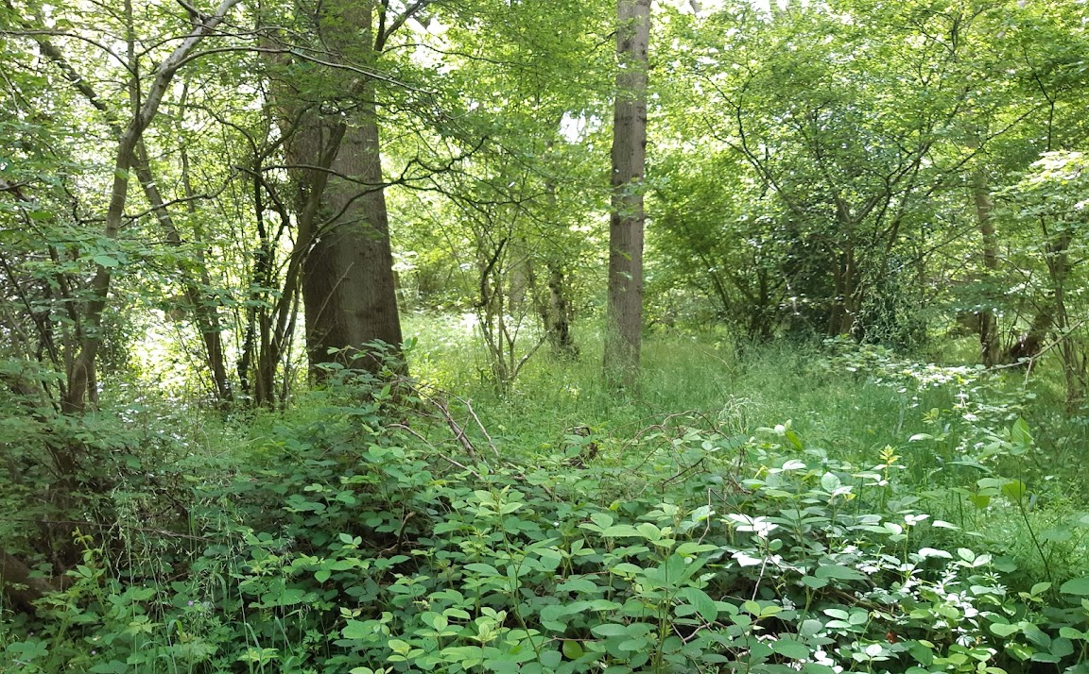
English Woodland and Timber Construction
Tristram Cary September 2026

Slide 2
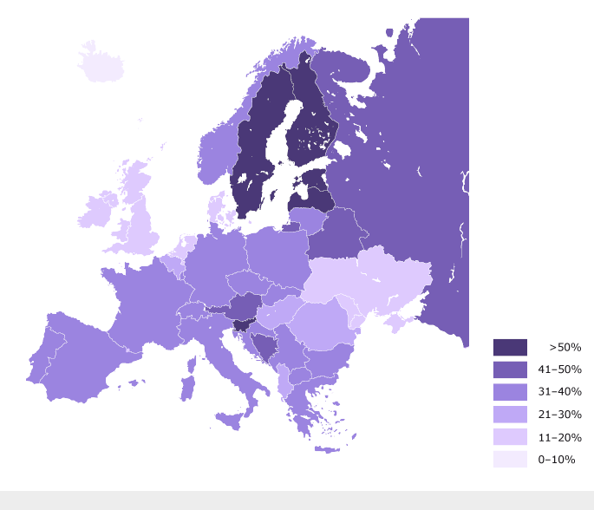
UK has very low tree-cover
UK has very little Woodland
Percentage of forest and woodland (2024)
UK/ (England) 13%/(10%)
Europe (EU) 31%
Europe (Total) 46%
World 31%
Our lack of woodland is one of the main reasons why our wildlife and habitats are so depleted
UK imports >80% of its timber (second only to China)
Source: Forestry Commission

Slide 3
Why is UK so short of woodland?
3,000 bc: 60% - 80% woodland cover
2,000 bc: neolithic farmers cleared trees for crops and grazing (faster than Europe)
From Tudor times Royal Navy used 2,000 to 6,000 mature oaks per warship
Industrial Revolution used land for mines, railways, towns, farms (growing population)
By 1919 woodland cover was 5% (its lowest point)
Forestry Commission founded in 1919 to support woodland re-generation

Slide 4
Government Woodland Policy (post Brexit)
England Trees Action Plan 2021-2024 (now Environment Improvement Plan (EIP))
£100m pa to triple the rate of woodland creation from 10,000 ha pa to 30,000 ha pa.
Target for 16.5% tree cover by 2050
Progress badly behind schedule
Timber in Construction Roadmap 2025
Reduce embodied carbon in buildings
Stimulate woodland creation and active forest management
Support economic growth

Slide 5
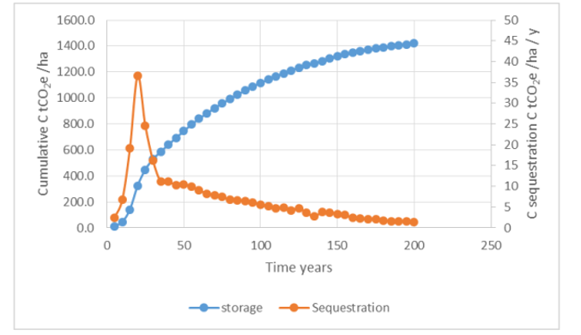
Mature Woodland does not sequester carbon, it only stores it
Source: Natural England Research Report NERR094 April 2021
(For un-thinned Oak)

Slide 6
Woodland Management Options (in Green)
Small Store
Max Harvest
Larger Store
Smaller Harvest
Max Store
Min Harvest

Slide 7
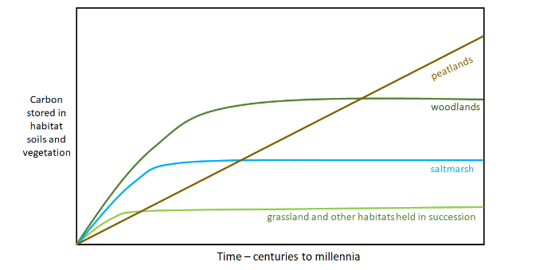
Only Peatlands go on sequestering carbon over the long term
Source: Natural England Research Report NERR094 April 2021

Slide 8
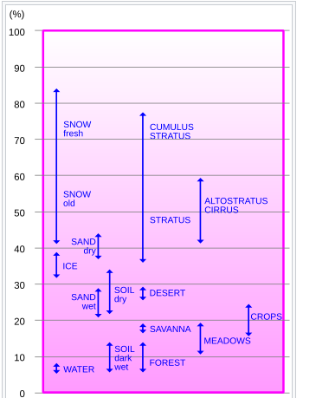
ALBEDO: Percentage of sunlight reflected from Earth’s surface
Note that woodland absorbs 90% of sun’s heat
So unmanaged Ancient Woodland is bad for global warming
Source: Wikipedia

Slide 9
Timber for Construction
40% of man-made carbon comes from the construction industry (mostly from making concrete and steel)
Using timber is (increasingly) a much better alternative
Wooden construction reduces ‘embedded carbon’ by c 35% (compared to concrete/steel)
Wooden construction also creates a ‘permanent’ carbon store
But:
  there is little tradition for timber houses in UK
  There is a perception that wooden houses won’t last

Slide 10
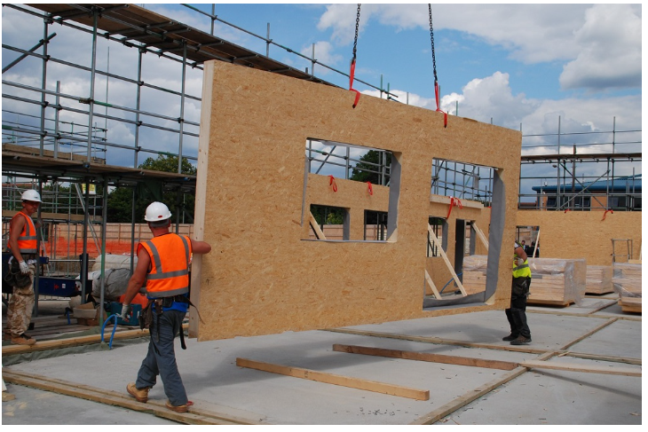
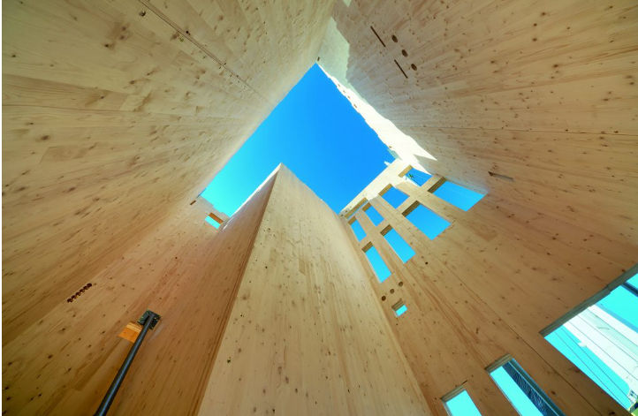
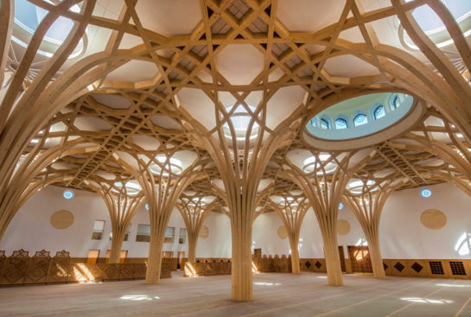
Engineered Timber
Timber for construction is increasingly ‘engineered’ to make it stronger, dimensionally stable, fireproof, rot-proof and water resistant.
Structural Insulated Panels (SIPs)
Cross Laminated Timber (CLT)
Glued Laminated panels (Glulams)

Slide 11
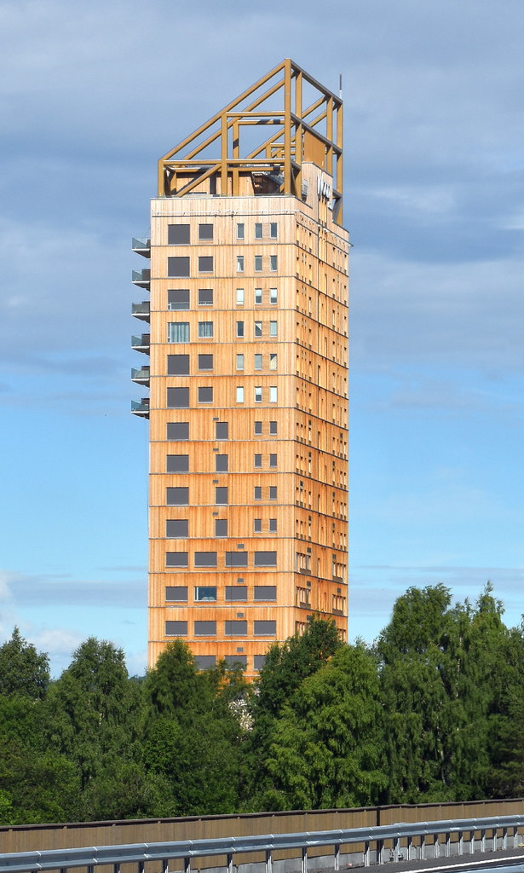
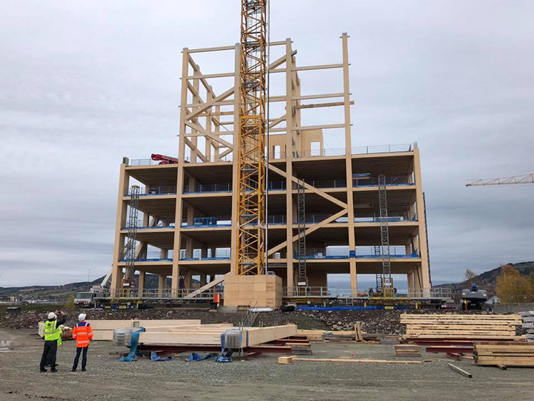
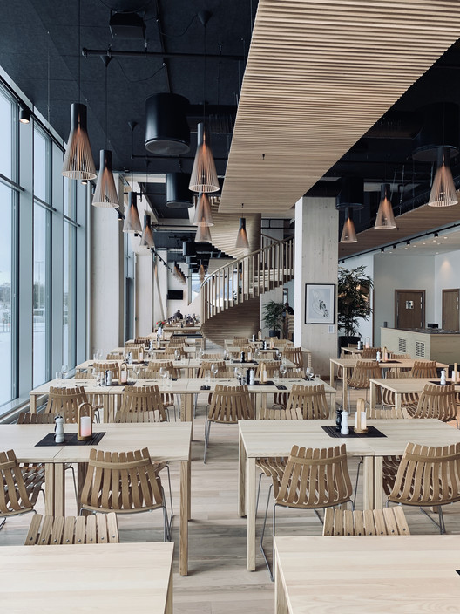
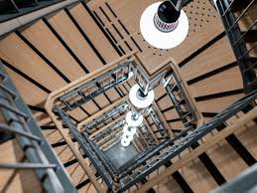
Mjøstårnet (Trondheim) (280ft/16 floors) is tallest wooden building.

Slide 12
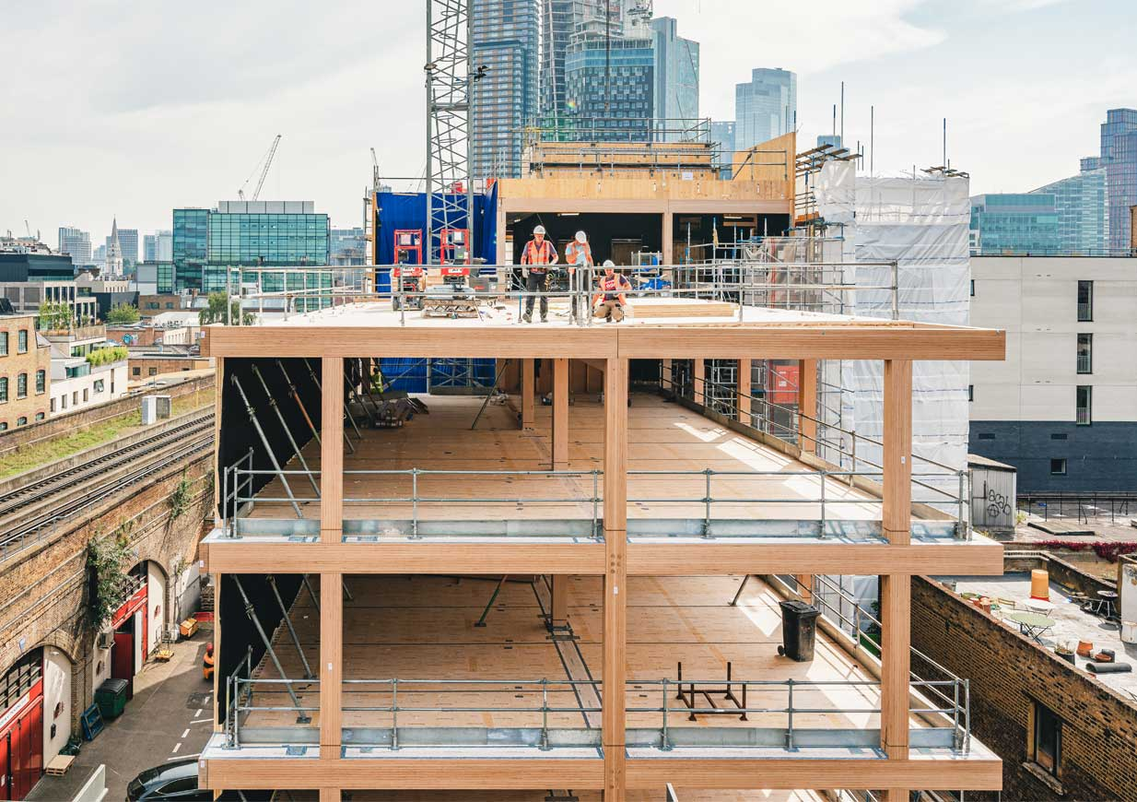
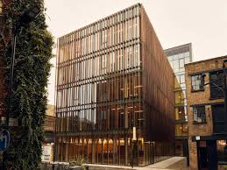
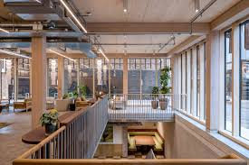
Black and White Office Building, Shoreditch

Slide 13
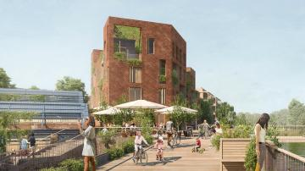
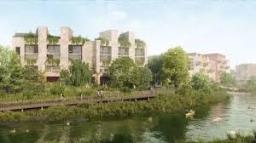
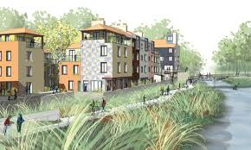
Lewes Phoenix Project
South Downs National Park
700 timber homes
Will store 500,000 tCO2e
Construction is now underway.

Slide 15
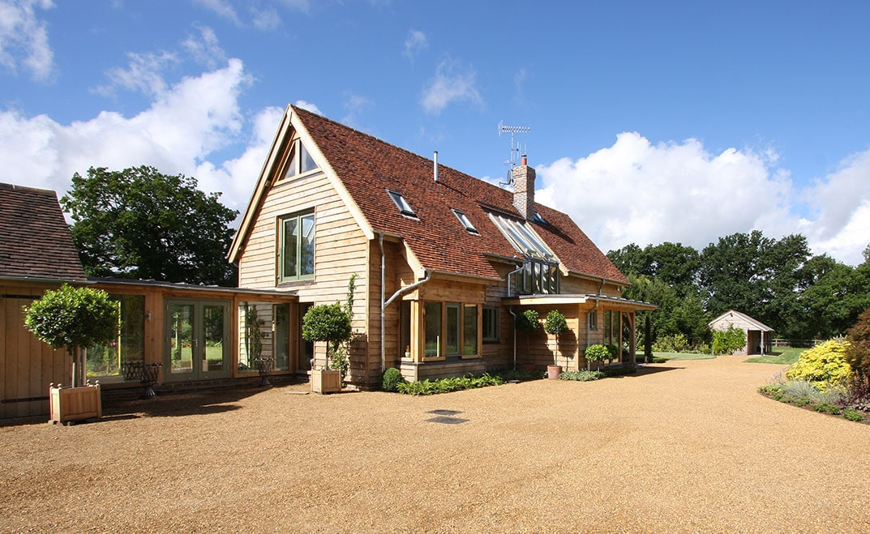
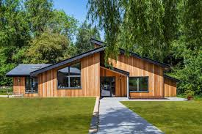

Slide 16
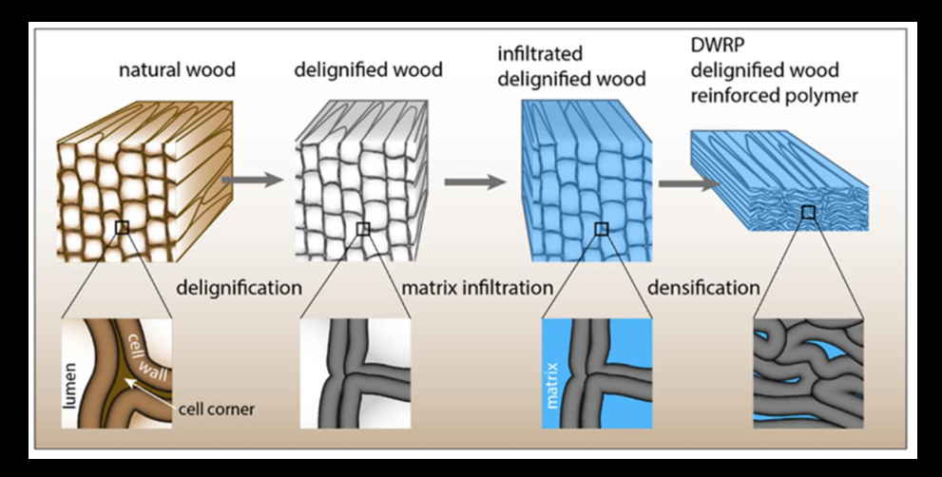
Superwood (by InventWood and Woodoo)

Slide 17
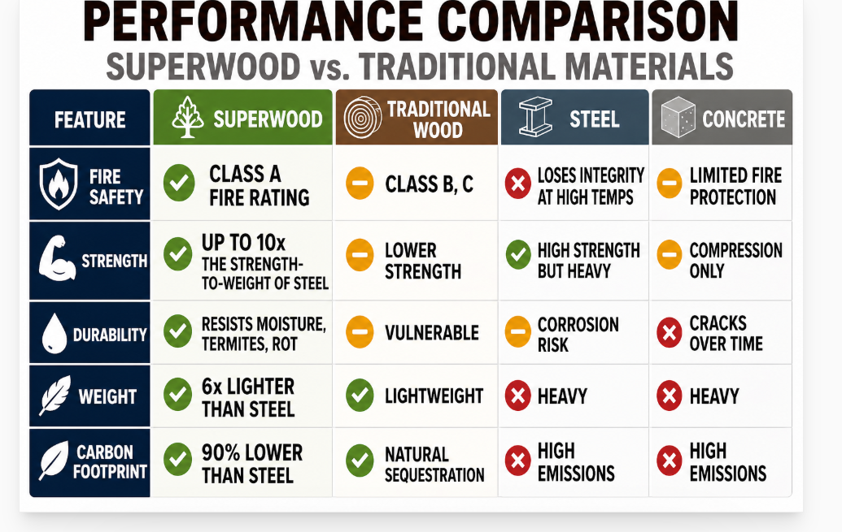

Slide 18
UK Housing Target (3 bed homes equivalent)
Growth target for new homes 300,000 pa
Number of homes in UK 30m
Average life of homes 100 years
  Therefore, need to rebuild 300,000 pa
TOTAL residential target 600,000 pa
Commercial buildings 300,000 pa
Total Buildings 900,000 pa

Slide 19
 | Timber Frame | SIP | CLT /Glulam
Cubic m of timber per 3 bed house | 12 | 8 | 35
Extraction (in m3) per ha per annum (mature pine/fir plantation) | 15 | 15 | 15
Ha per house | 0.8 | 0.53 | 2.33
sq km per house | 0.008 | 0.0053 | 0.023
Sq km for 600,000 houses | 4,800 | 3,180 | 13,800
% of area of UK (243,610 sq km) | 2.0% | 1.3% | 5.6%
Sq km for 900,000 houses | 7,200 | 4,770 | 20,700
% of area of UK | 3% | 1.95% | 8.4%

Slide 20
Conclusion and notes
The UK woodland target (16.5% cover by 2050) is easily enough to fulfil UK’s complete timber requirement.
Especially if Mature/Ancient woodland is managed so that it can sequester ‘new’ carbon
Note that engineered wood can use any sort of timber – you no longer need large straight planks

Slide 21
Financial Viability
UK lags far behind Europe (Austria/Scandinavia) in engineered wood production (smaller forests/woodland, more mixed species, less established infrastructure)
But Defra is now free (post CAP) to subsidise woodland to pay for other Ecosystem services (soil stability, biodiversity, clean air, shade, flood prevention, water quality, access to nature etc)
So:
  subsidies can be designed to make timber for construction financially viable
  extraction and engineering is making good progress (UK engineered wood growing at 15% pa since 2015 (from a v low base))

Slide 22
England Woodland Creation Offer (EWCO)
Allows payments to be ‘stacked’ for the same piece of woodland. Eg
Woodland carbon credits
Biodiversity units
Flood mitigation
Access to nature
Etc

Slide 23
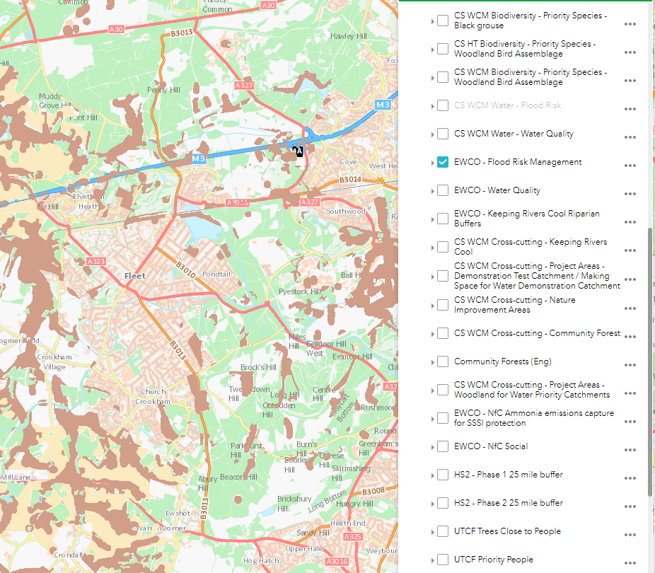
https://www.forestergis.com/Apps/MapBrowser/

Slide 24
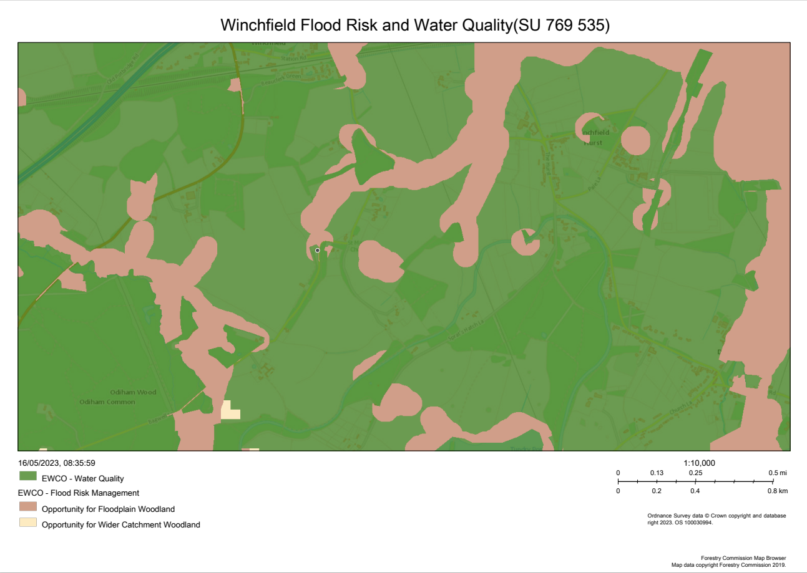

Slide 25
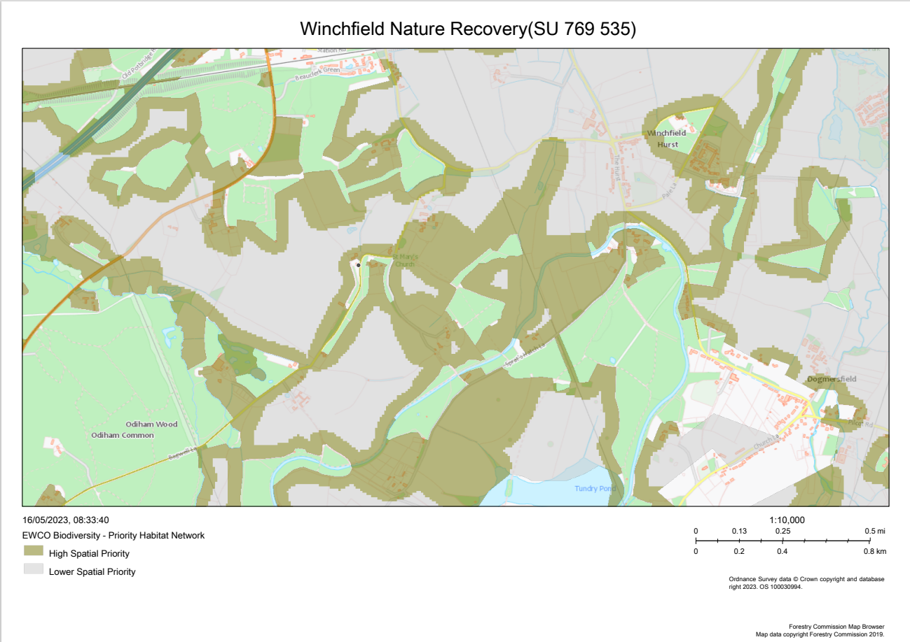

Slide 26
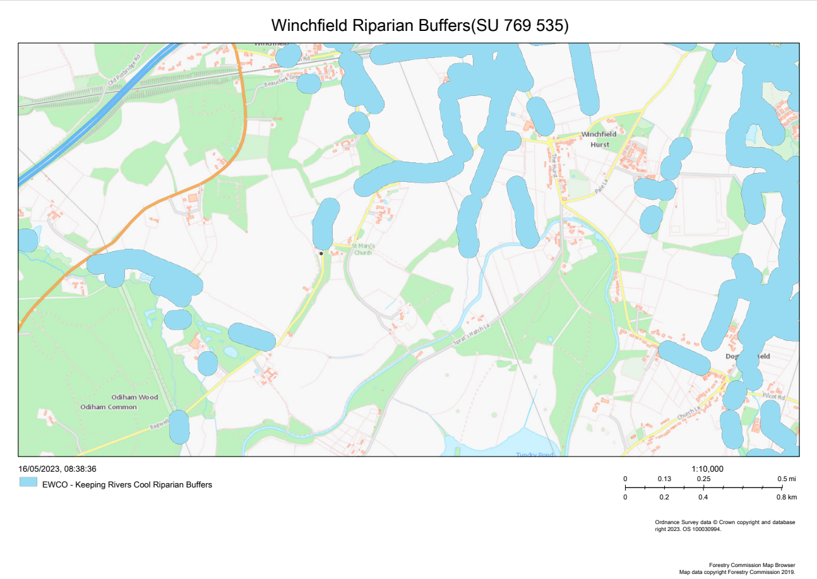

Slide 27
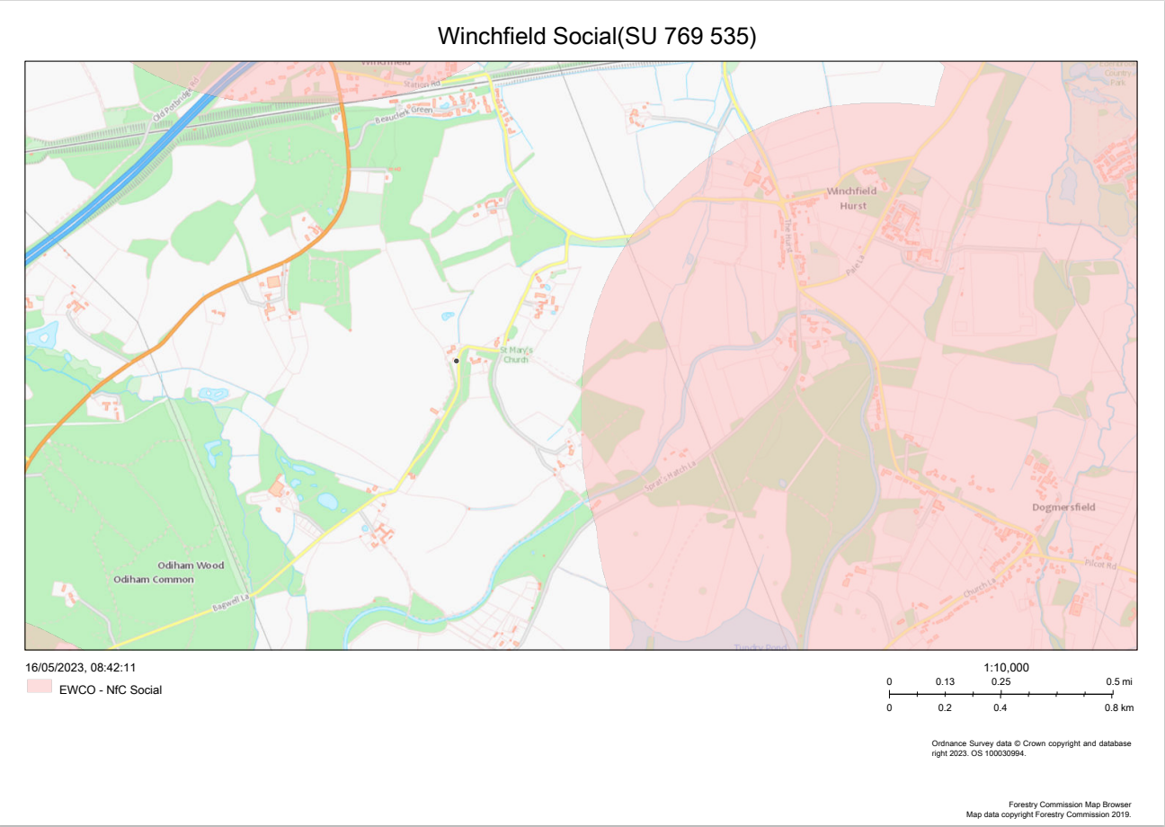

Slide 28
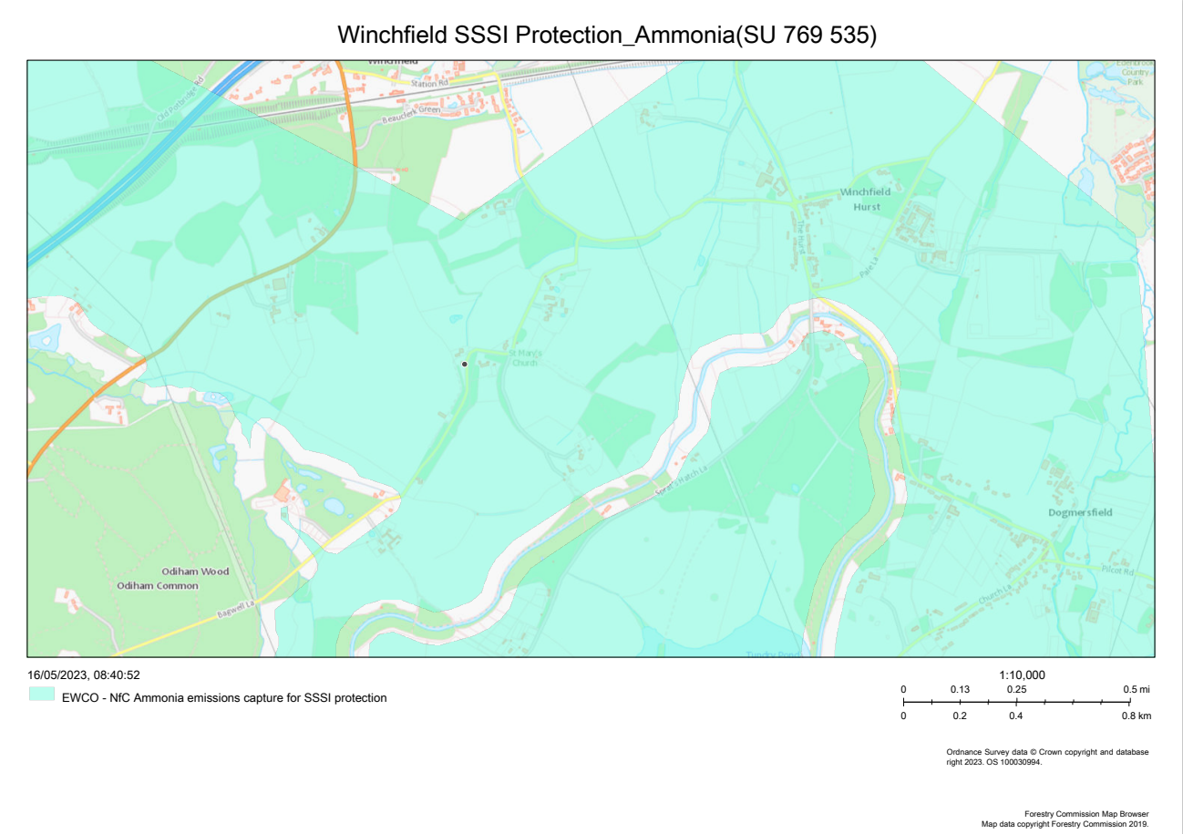

Slide 29
Woodland opportunities at Parish Level

Slide 30
England Woodland Creation Offer
EWCO grants are for a minimum area of 2 ha, so not available to small landowners, gardens etc
But DEFRA is prepared to work with groups of (non-contiguous) landowners
This needs to be done through a legal entity (such as a Community Interest Company or Co-op)
Is this an opportunity for Odiham and other Hart parishes?

Slide 31
Process to develop Odiham parish-level woodland plan
Identify woodland opportunity areas
Exclude areas earmarked for other purposes in Neighbourhood Plan/Local Plan
Discuss with Landowners
Group Landowners under a CIC or Coop
Apply for DEFRA grants
Also, support timber construction in Neighbourhood and Local Plans

Slide 32
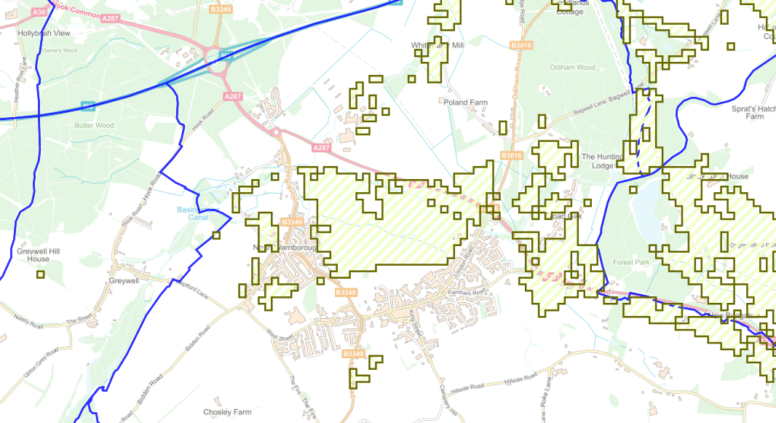
Odiham Woodland Opportunity Areas (Friends of the Earth)

Slide 33
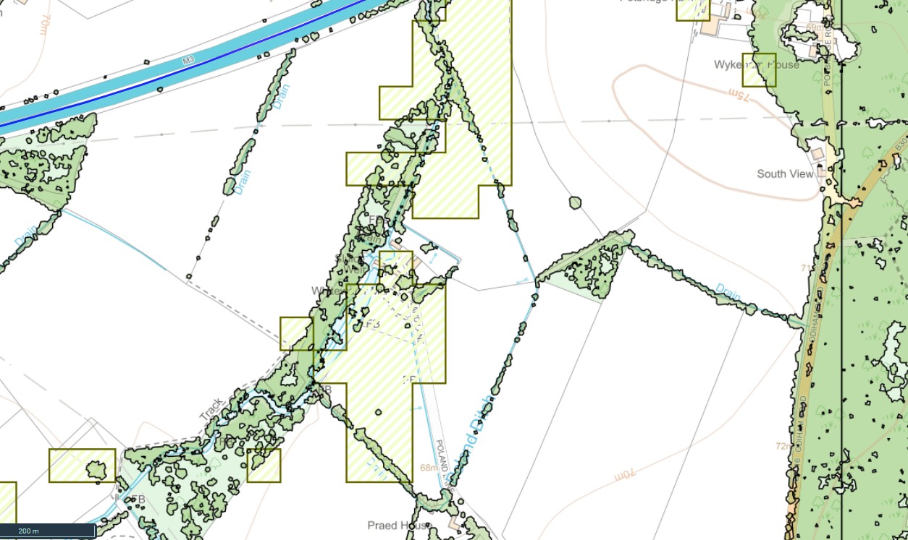




Tree Planting Opportunities
Odiham Tree Cover (Friends of the Earth)

Slide 34
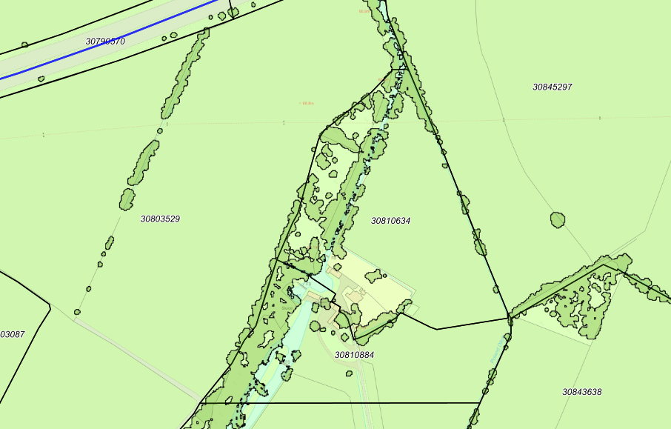
Use Land Registry Polygons to identify Landowners

